Slide 1
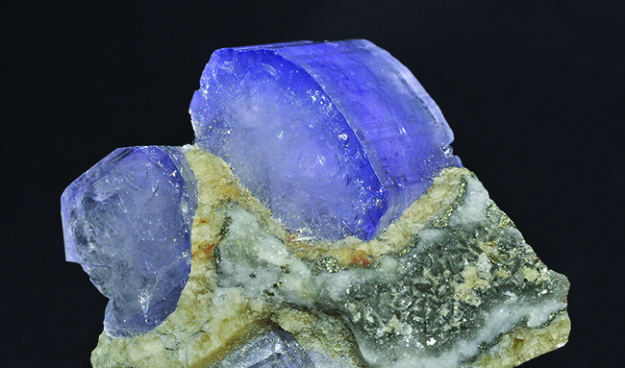
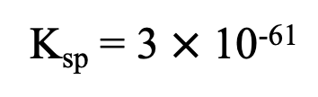
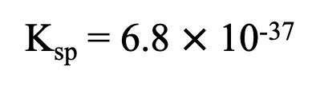
The main mineral component of teeth is calcium hydroxyapatite Ca₅(PO₄)₃OH.
This is the same mineral, but as a crystal - not in a tooth. The color in this sample is due to small amounts of impurities.
Ca₅(PO₄)₃OH(s) ⇌ 5Ca²⁺ (aq) + 3PO₄³⁻(aq) + OH⁻(aq)
K_{sp} = 6.8 $×$ 10⁻³⁷
Ca₅(PO₄)₃F(s) ⇌ 5Ca²⁺ (aq) + 3PO₄³⁻(aq) + F⁻(aq)
K_{sp} = 3 $×$ 10⁻⁶¹
H⁺ reacts with multiple anions here – especially with the OH⁻!

Slide 2
Discuss!
Does the solubility of teeth change in the presence of an acid?
How does the solubility of teeth treated with fluoride change in the presence of an acid?

Slide 3
Discuss!
Does the solubility of teeth change in the presence of an acid?
Yes! H⁺ reacts with OH⁻ to form H₂O, and Le Chatelier’s Principle says if you remove a product, the system shifts to make more product. Product is ions.
How does the solubility of teeth treated with fluoride change in the presence of an acid?
H⁺ reacts with F⁻ to form HF, and Le Chatelier’s Principle says if you remove a product, the system shifts to make more product. Product is ions. K_{sp} is much smaller, and fluoride is a weaker base, so reacts less with acid.

Slide 4
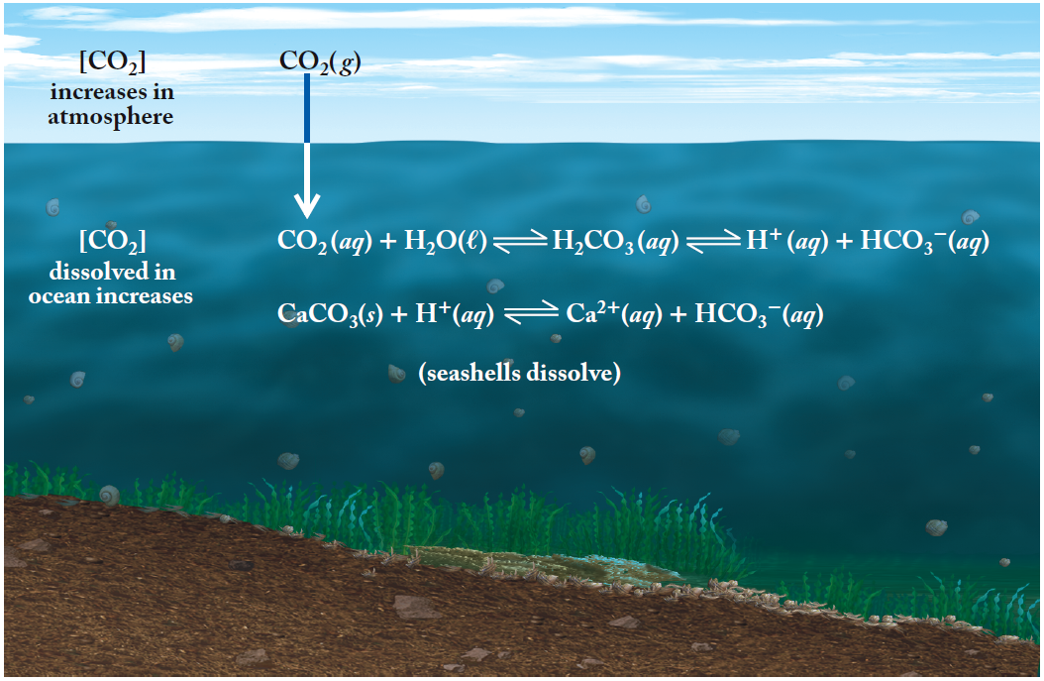
Acidification of the Oceans
Notes:
The pH of the ocean is lowering. This alters the solubility of the exoskeletons of marine organisms (calcium carbonate).

Slide 5
Discuss!
What does CO₂ form when it reacts with water?
Are global CO₂ levels changing?
What effect does this have on the pH of ocean water?
What effect does this have on the solubility of CaCO₃? Why?

Slide 6
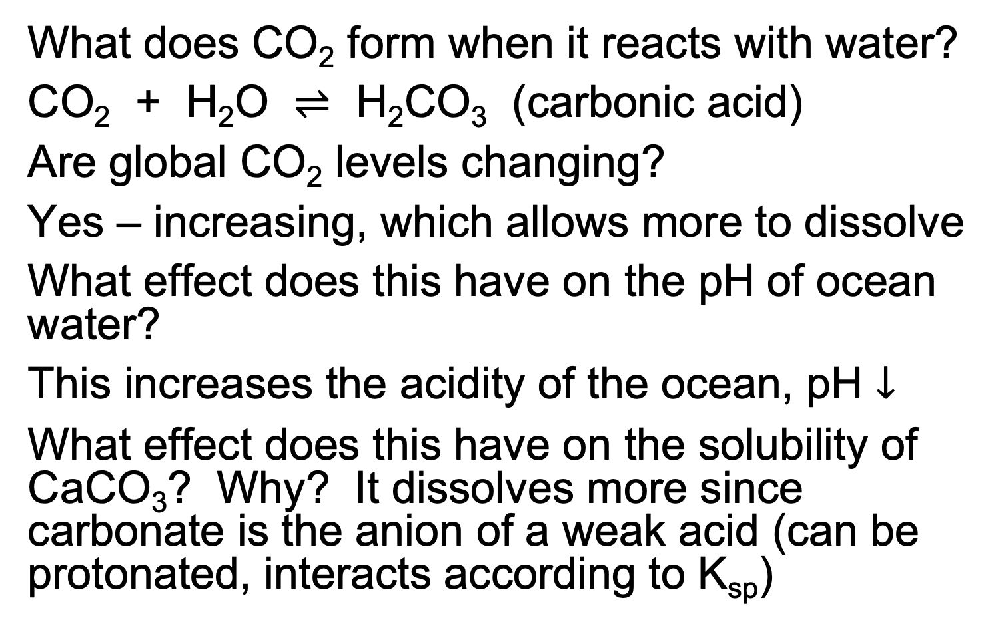
Discuss!
What does CO₂ form when it reacts with water?
CO₂ + H₂O $⇌$ H₂CO₃ (carbonic acid)
Are global CO₂ levels changing?
Yes – increasing, which allows more to dissolve
What effect does this have on the pH of ocean water?
This increases the acidity of the ocean, pH $↓$
What effect does this have on the solubility of CaCO₃? Why? It dissolves more since carbonate is the anion of a weak acid (can be protonated, interacts according to K_{sp})

