Slide 1
Nuclear Power Plants
Sustainability Profile

Slide 2
Nuclear Energy
~100 nuclear reactors in the United States generating ~20% of US electricity; no newly operating plants between 1996 and 2016; Watts Bar 2 in Tennessee is the new US plant; Vogtle 3 and 4 in Georgia to come on-line in 2021 and 2022
~450 nuclear reactors worldwide. France generates ~80 of its electricity from nuclear power
PROS: no CO2 emissions; dispatchable (available 24/7) vs. variable or intermittent (as with solar and wind); energy dense—1 million times as energy dense as hydrocarbon fuels
CONS: storage of hazardous nuclear waste; nuclear weapons proliferation; expensive initial investment; risk of nuclear accidents (Three Mile Island in 1979; Chernobyl in 1986; Fukushima Dai-ichi in 2010)

Slide 3
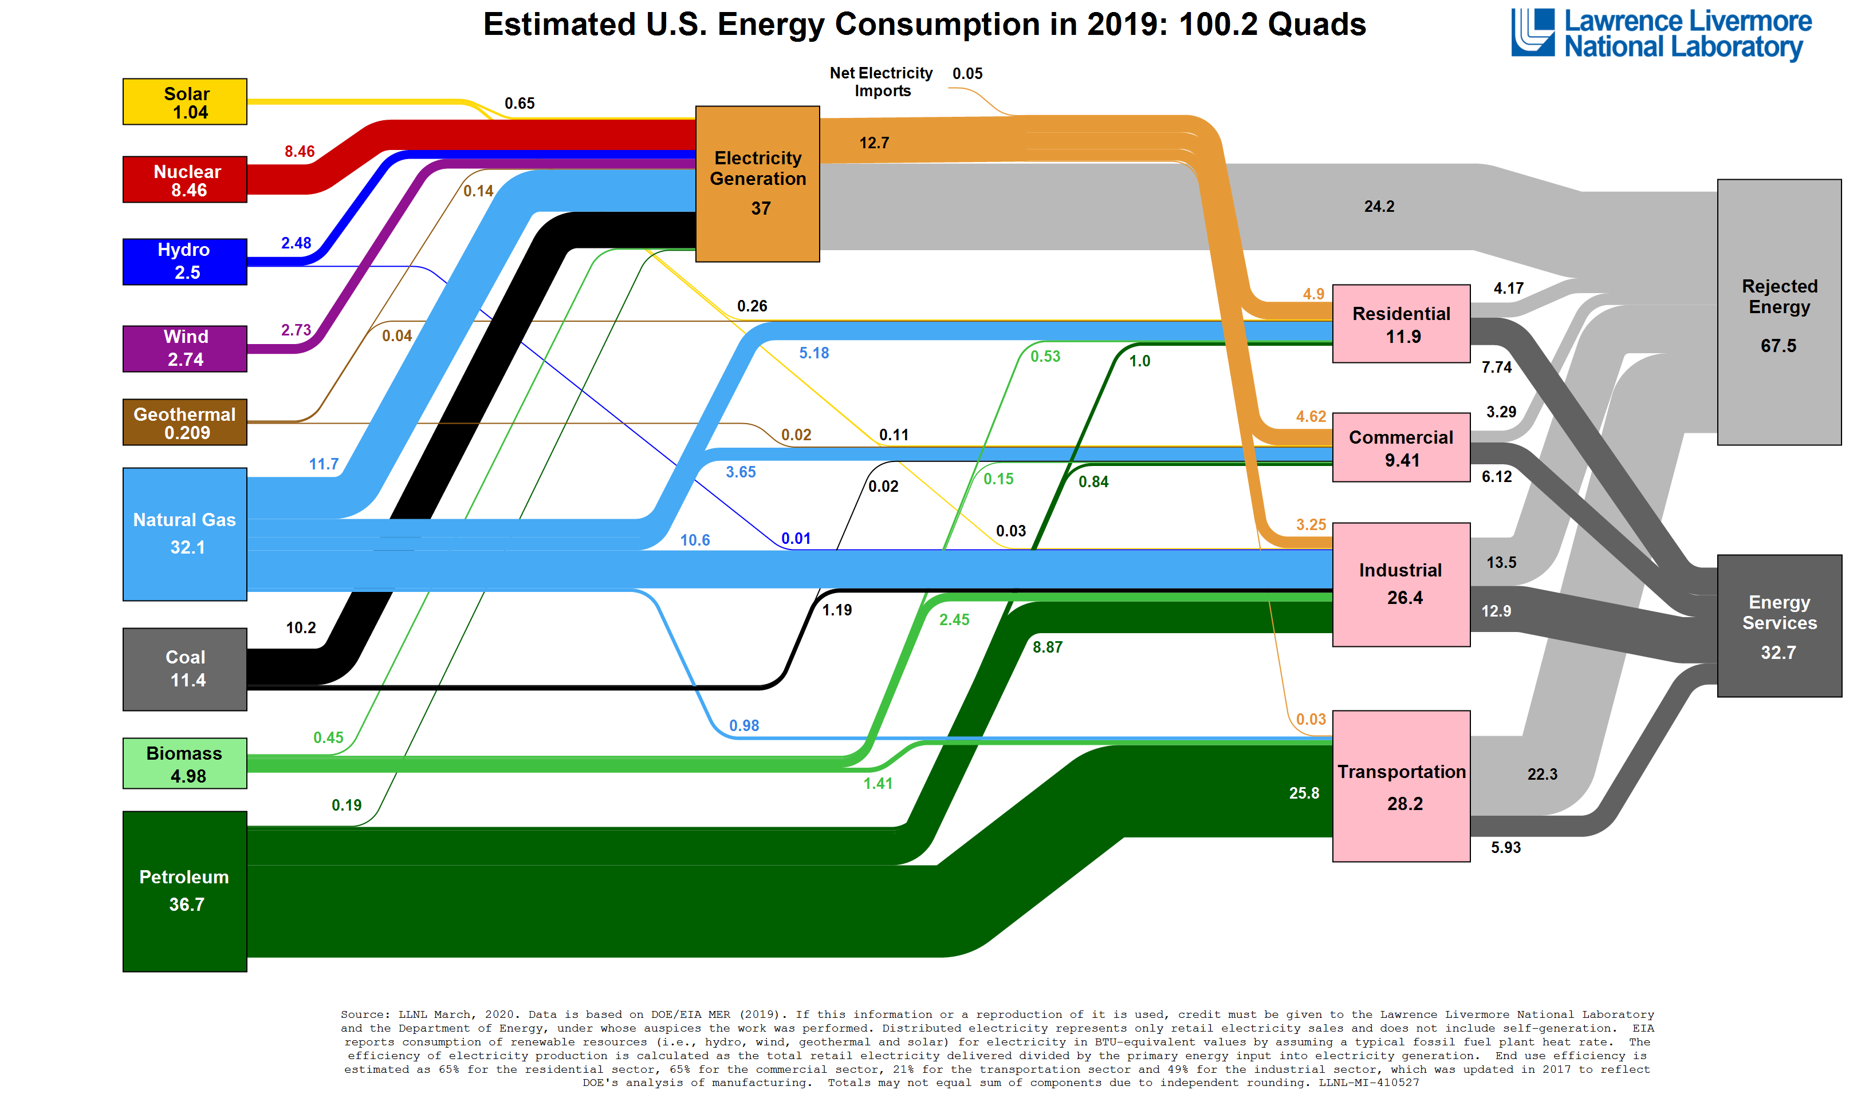

Slide 4
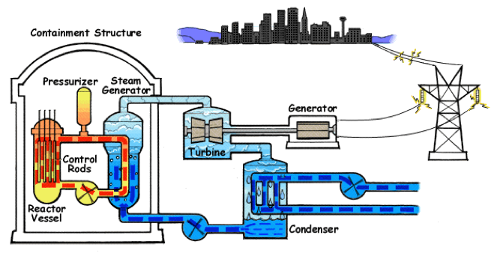
Light Water Reactor
Similar to coal-fired power plant except energy from a nuclear reaction is used to make high pressure steam instead of the combustion of coal. Boiler, turbine, generator, condenser are all basically the same.
The reactor vessel where the nuclear fission reaction takes place contains:
1) fuel rods containing enriched ²³⁵U
2) boron, cadmium, or carbon control rods that absorb neutrons to control the chain reaction
3) a moderator (in “slow reactors”) such as pressurized liquid water (the red, orange, and yellow in the schematic)
4) a coolant or heat transfer material (also the red, orange, and yellow in the schematic.

Slide 5
Small Modular Reactors
Smaller size and modularity allows for factory mass production that reduces cost
Pre-assembled reactors can be shipped by truck or rail
https://www.youtube.com/watch?v=wDMsXEur1fs

Slide 6
4th Generation Reactors: VHTR
Variable High Temperature Reactors (VHTR)
Graphite (not water) moderators
Less risk of water decomposition and hydrogen explosion when overheated
Helium or molten salt is the coolant and heat transfer medium; safer, lower pressure operation
Once-through fuel cycle with fuel rods that must be replaced approximately yearly

Slide 7
4th Generation Reactors: MSR
Molten Salt Reactor (MSR)
High temperature, but low pressure operation; good heat distribution; expands upon overheating which makes the nuclear reaction go sub-critical
Less risk of water decomposition and hydrogen explosion when overheated
Freeze plug allows for fuel to be removed from the reactor upon overheating
Closed fuel cycle when fuel is mixed with molten salt; waste can be removed, new fuel added on a continuous basis

Slide 8
Nuclear Waste
Today’s nuclear fuel contains only 3-4% fissionable material (²³⁵U)
Today’s nuclear waste include fission products but also the 96-97% unfissionable ²³⁸U and transuranium unfissioned transmutation products
Nuclear waste is typically stored on-site; this may seem bad, but coal-fired power plant waste is emitted into the atmosphere. Coal ash is often simply buried in the ground.
Next generation fast reactors would only produce fission products. ²³⁸U would be transmuted into fissionable transuranium elements and subsequently fissioned. Much less waste is produced and the fission products are relatively short-lived.

Slide 9
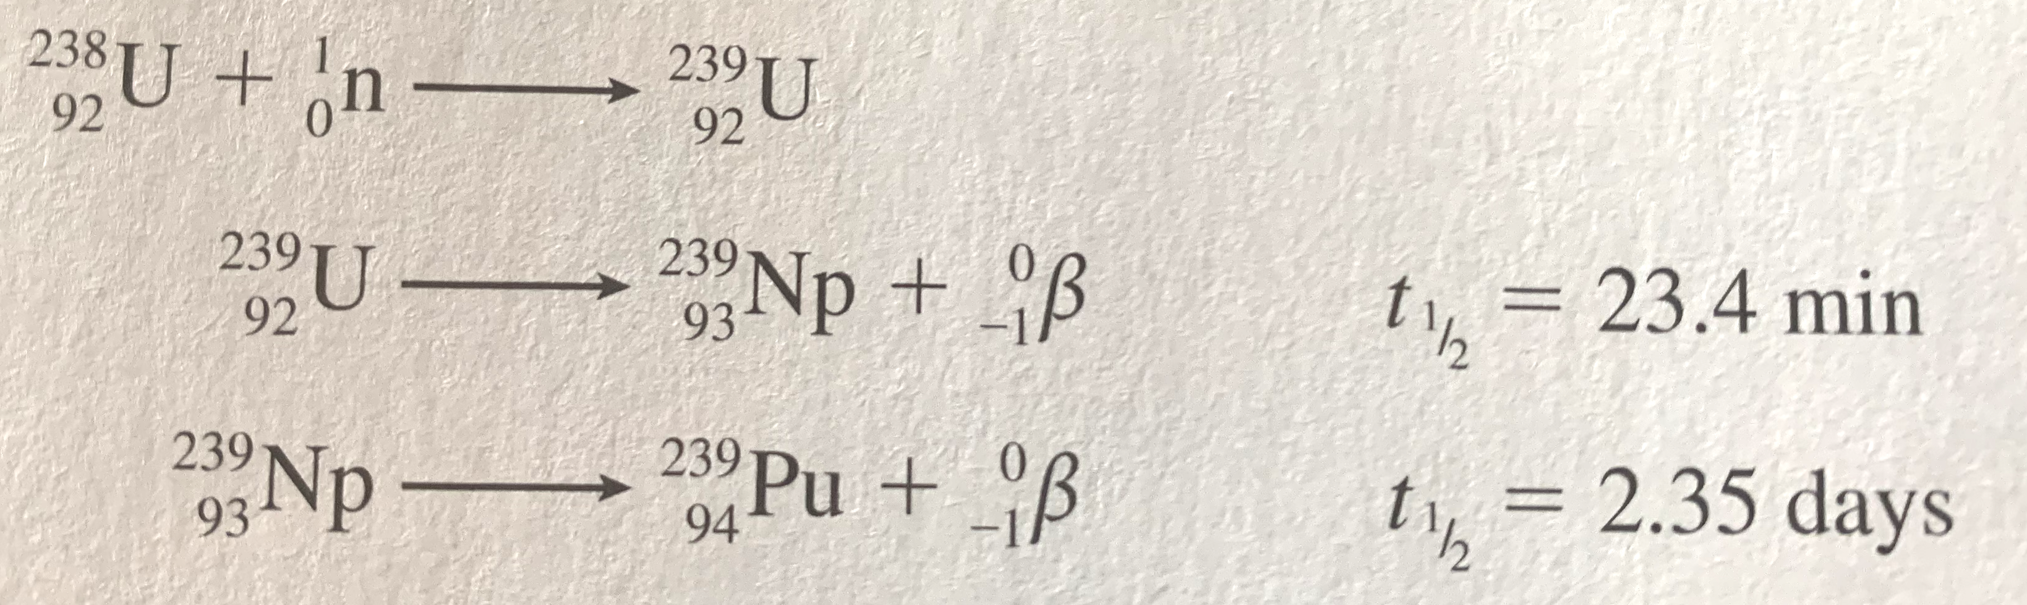
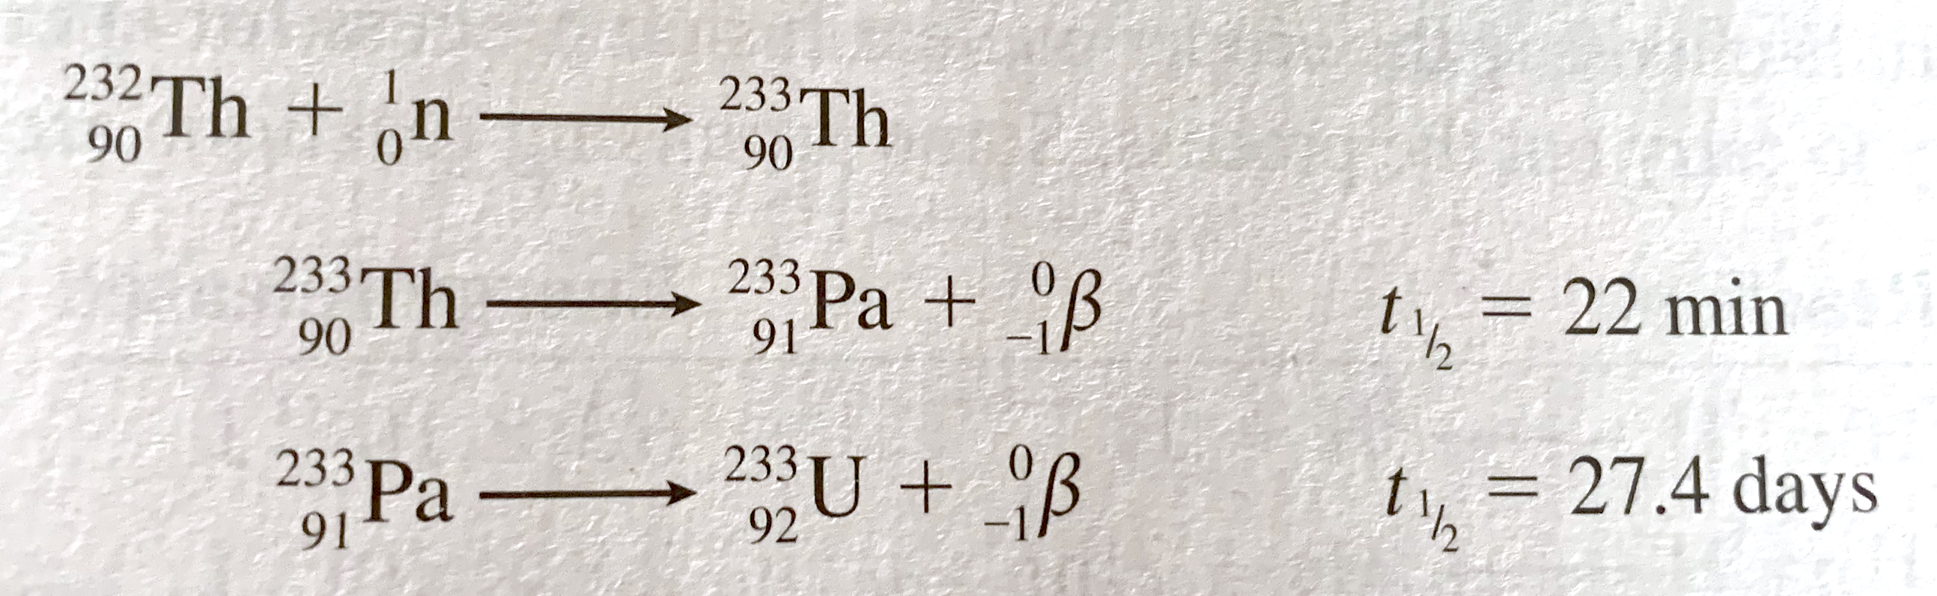
Breeder Reactor Reactions
Unfissionable ²³⁵U transmuted into fissionable ²³⁹Pu
Unfissionable ²³²Th transmuted into fissionable ²³³U

Slide 10
4th Generation Reactors: SFR
Sodium Cooled Fast Reactor (SFR)
High temperature, but low pressure operation; good heat distribution; expands upon overheating which makes the nuclear reaction go sub-critical and stop
Less risk of water decomposition and hydrogen explosion when overheated; although molten sodium must not ever come in contact with water.
Fast neutrons enable breeder reactions; nuclear waste and unfissioned isotopes are transmuted into fissionable material and then fissioned.
Closed fuel cycle; core is robotically removed, processed, and re-used; spent nuclear fuel (SNF) can be used
Traveling Wave Reactor uses similar technology but has a one time using up of the fuel over a multi-decade time period.
Integral Fast Reactor: https://www.youtube.com/watch?v=Sp1Xja6HlIU
Traveling Wave Reactor: https://www.youtube.com/watch?v=qwRYtiSbbVg

