Slide 1
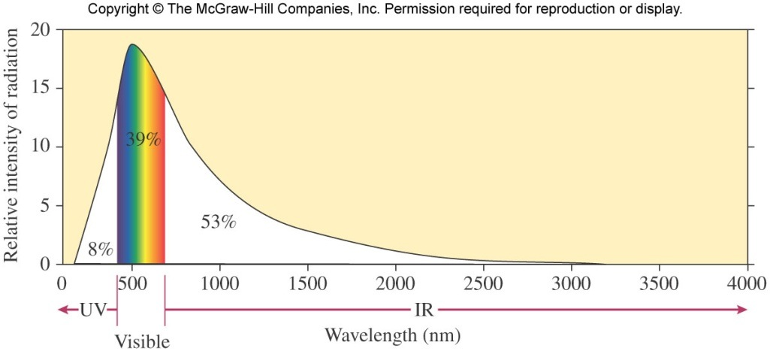
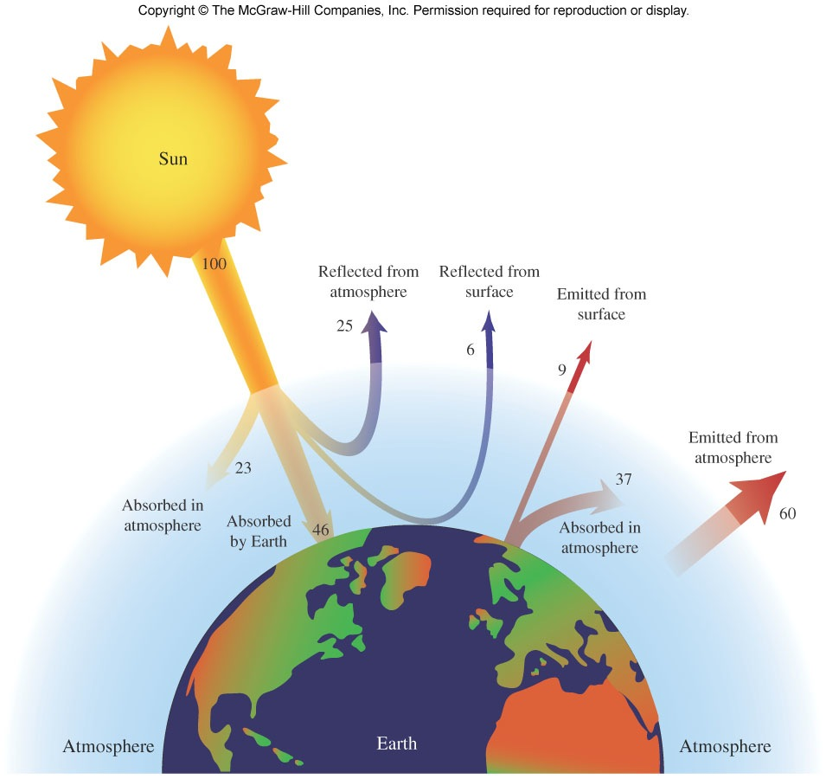
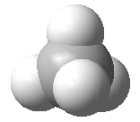
Solar Energy Balance
solar radiation: more than half is infrared (IR)
Avg. surface T on Earth = 15 °C
(should be -18 °C based on distance to the Sun)
(59 °F vs 0 °F)
37/46=83%
Atmosphere keeps solar energy from (a) focusing only on earth surface and (b) leaving Earth too quickly
Greenhouse effect: ~80 % of the energy emitted from Earth’s surface is absorbed by molecules in the atmosphere

Slide 2
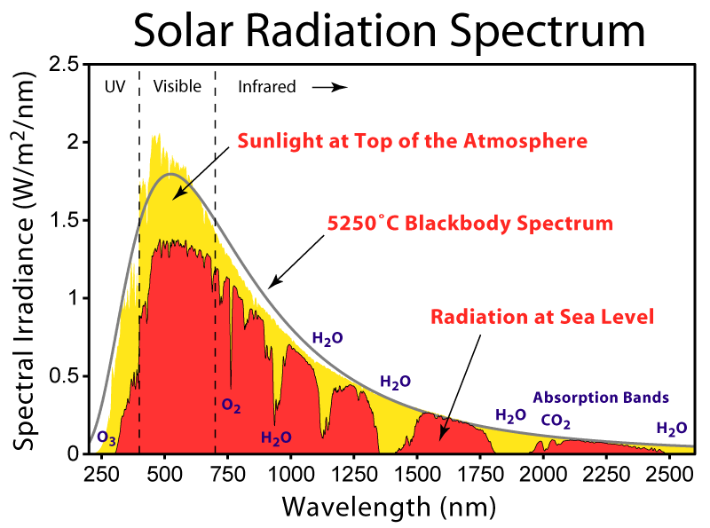
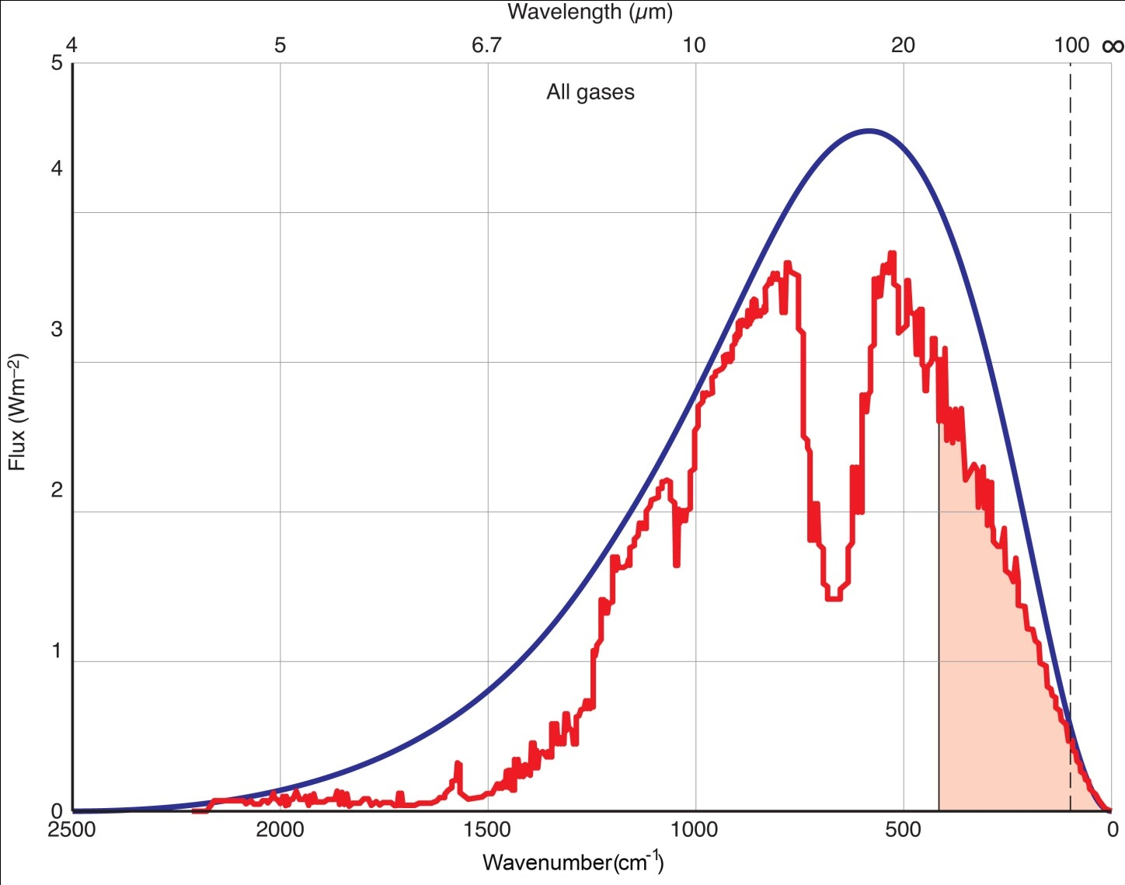
Greenhouse effect, Solar Spectrum
1μm=1000 nm
Light out
Light in
Prof Keith Shine at the University of Reading

Slide 3
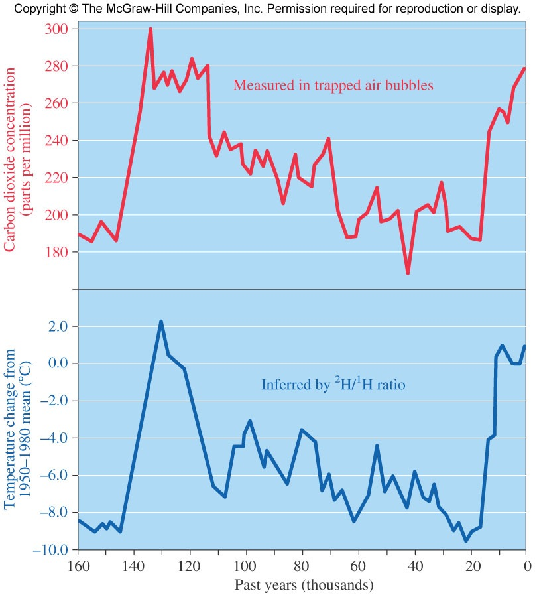
Correlation Between CO₂ Levels and Temperature
How do we know about carbon dioxide and temperature in the past? Enter Antarctica…
CO₂
directly measured in gas bubbles trapped in ice
Temperature
indirectly measured by looking at ²H:¹H ratios in the ice: water that contains ²H isotopes condenses more readily than water with ¹H
the ²H:¹H ratio depends on temperature (beyond the scope of this course at this time)
The CO₂ and T data appear to be correlated

Slide 4
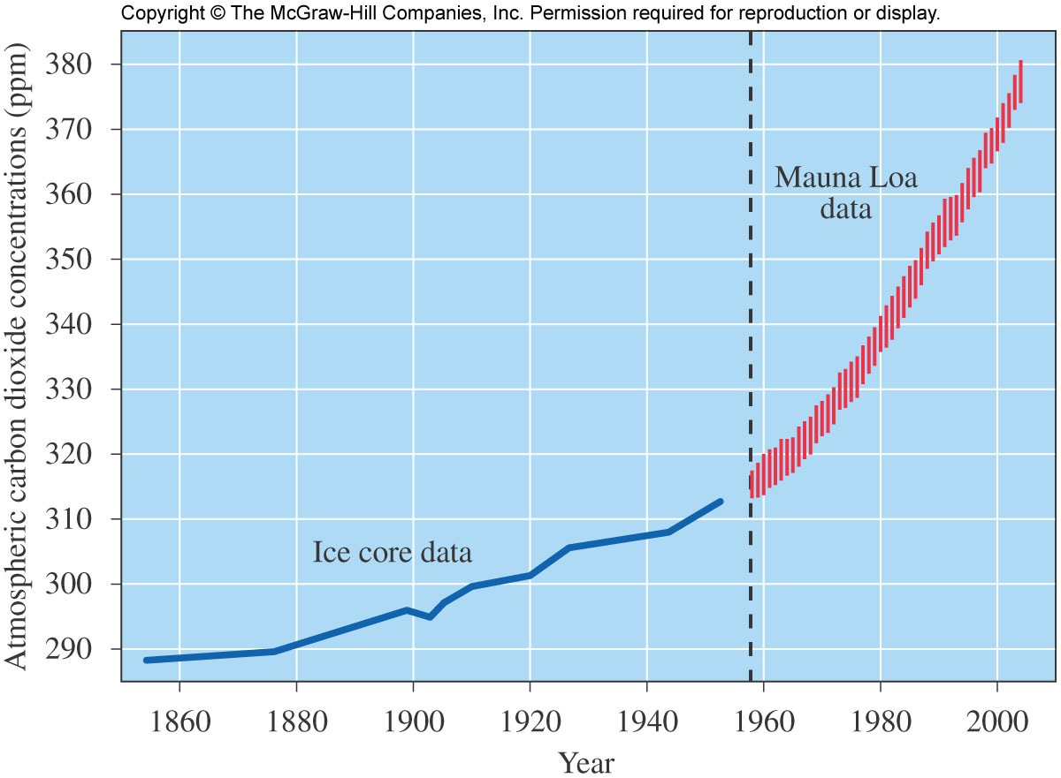
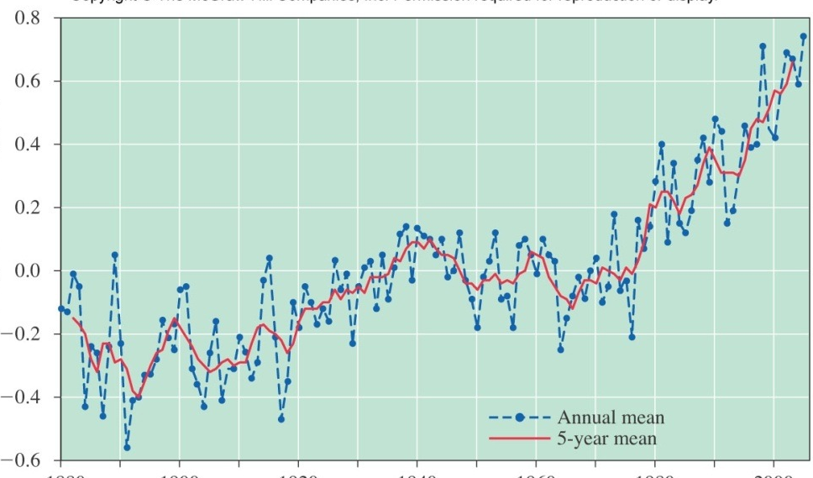
[CO₂] and T: Present Tense
Greenhouse effect—absorption of heat radiation by atmospheric gases
80% of the energy absorbed and then re-emitted by the Earth is gobbled up by the atmosphere
represents a steady state condition
Enhanced greenhouse effect—absorption of heat beyond the 80%
We are currently involved in an interesting and unprecedented (for humans) experiment: how will the Earth respond to [CO₂] > 400 ppm?
CO₂ conc. (ppm)
T anomoly (deg C)
1860
1880
1900
1920
1940
1960
1980
2000

Slide 5
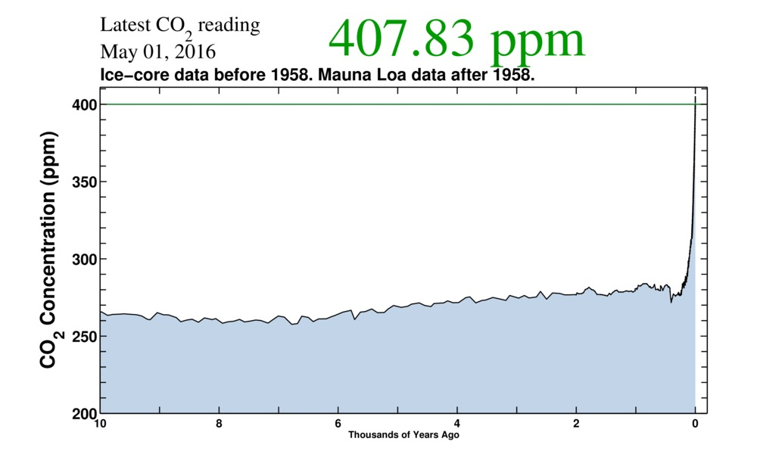
CO2 Concentrations

Slide 6
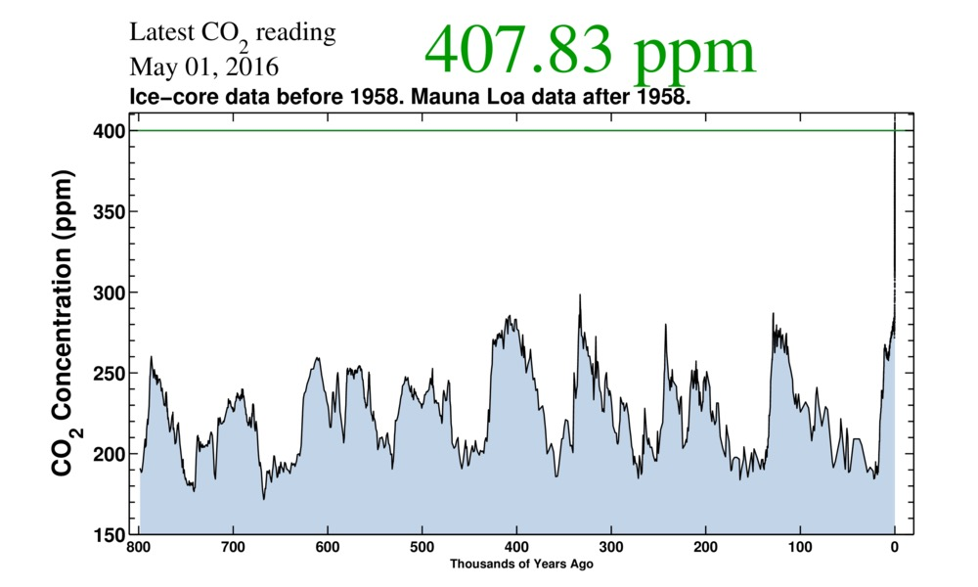
CO2 Concentrations

Slide 7
CO2 from Fossil Fuels

Slide 8
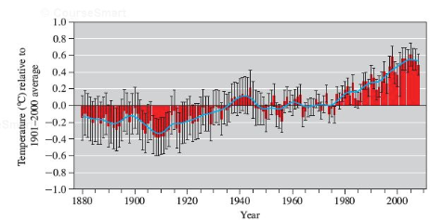
Land Temperature Changes

Slide 9
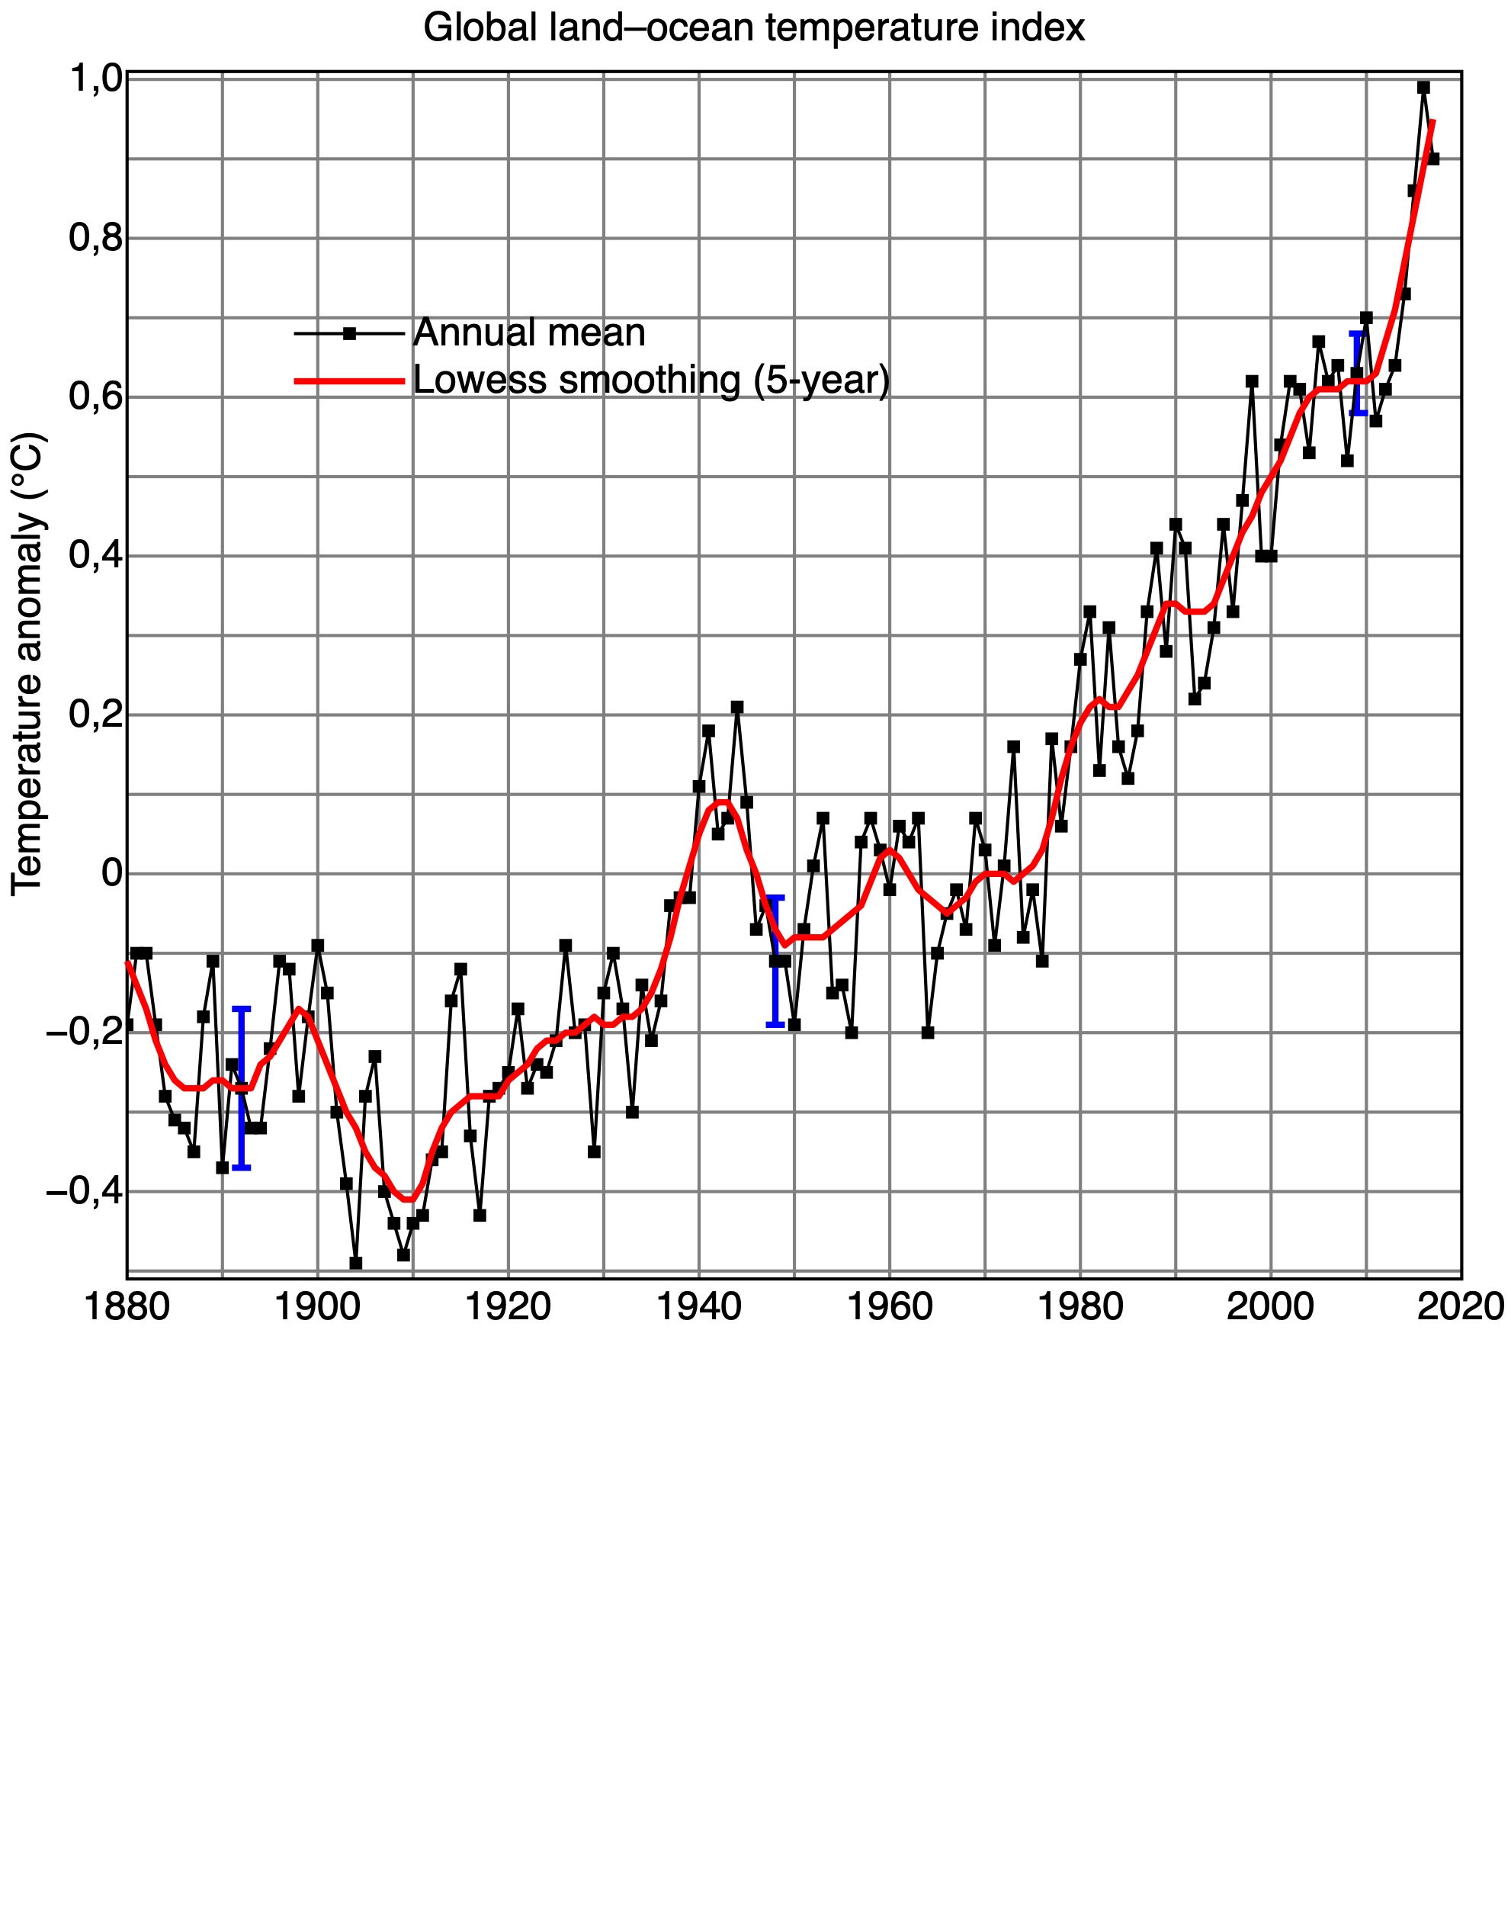
Land Temperature Changes

Slide 10
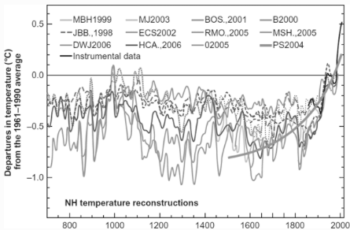
The “Hockey Stick”

Slide 11
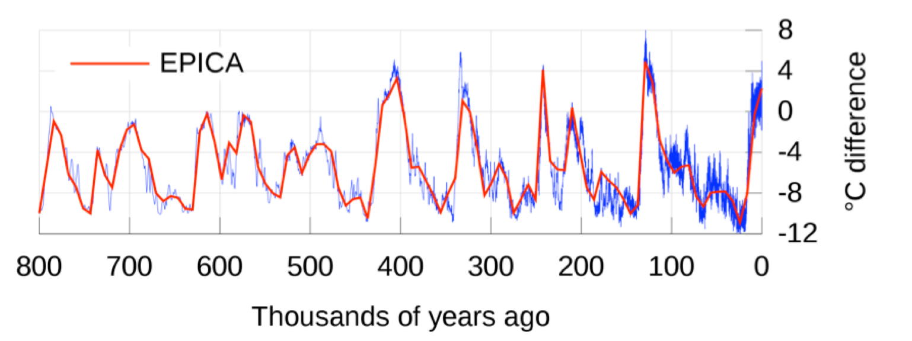
Long Term Temperature Record

Slide 12
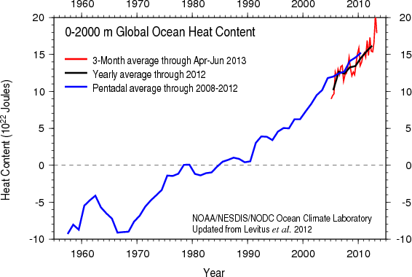
Ocean Heat Changes
https://www.youtube.com/watch?v=047vmL6Q_4g

Slide 13
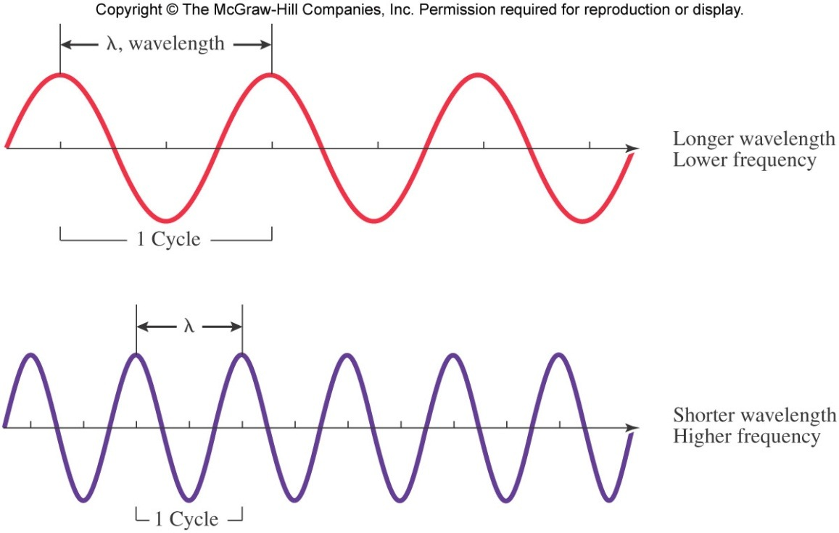
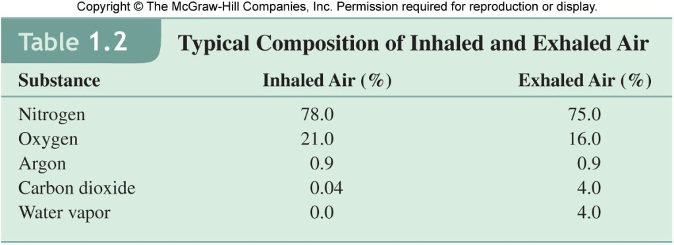
Light Absorption Requirements
For a substance to absorb light, there must be a change in dipole that occurs for that substance.
Thus, for a molecule to absorb IR radiation, there must be a change in the center of mass of the molecule—shape matters
-
+
dipole
Atmospheric gases: N₂ and O₂ don’t absorb IR light, but CO₂ and H₂O do…
N₂ and O₂ are not greenhouse gases, but CO₂ and H₂O are…

Slide 14

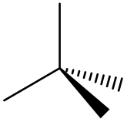


Determining Molecular Shapes Using Steric Numbers
Basic procedure:
1. Determine # outer/valence electrons for each atom (Unit 3.2)
2. Arrange outer/valence electrons so each atom has noble gas configuration (Unit 3.2)
3. Electrons repel (but are attracted to protons) so want to be as far apart as possible—think 3-dimensionally
3D structure drawing:
if steric number (SN) = 2 (2 pairs or bonds): think linear
if SN = 3 (3 pairs or bonds): think trigonal planar
if SN = 4 (4 pairs or bonds): think tetrahedral
if SN = 5 (5 pairs or bonds): think trigonal bipyramidal
if SN = 6 (6 pairs or bonds): think octahedral
Remember that (when asked on an exam) the molecule’s shape depends only on the positions of atoms, not (lone pair) electrons
SN = 3
SN = 4
SN = 5
SN = 6

Slide 15
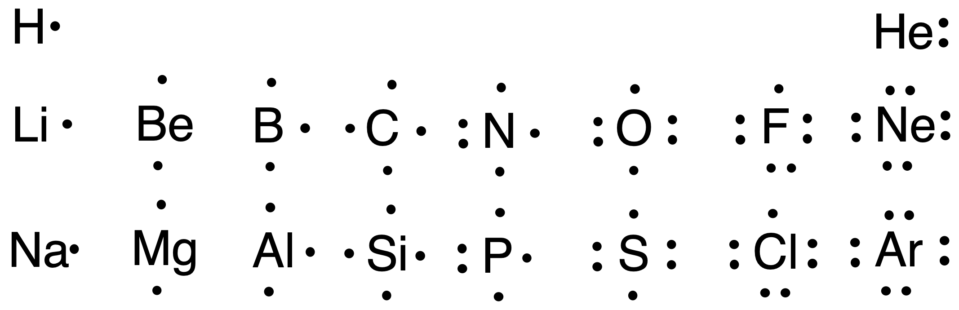
Practice Drawing Molecules
Examples to try:
1. O₃ (ozone)
2. CF₂Cl₂ freon 12 (CFC-12)
3. CO₃^{2–} (carbonate)
4. CH₃SH (methane thiol)
5. C₂H₄ (ethylene)
6. C₂H₆O (ethanol or dimethyl ether)
7. NO₃– (nitrate)
8. SF₆ (sulfur hexafluoride)
Basic procedure:
1. Determine # outer/valence electrons for each atom (Unit 3.2)
2. Arrange outer/valence electrons so each atom has noble gas configuration (Unit 3.2)
3. Electrons repel (but are attracted to protons) so want to be as far apart as possible—think 3-D
The molecule’s shape depends only on the positions of atoms, not (lone pair) e⁻
SN = 3
SN = 4
SN = 5
SN = 6

Slide 16
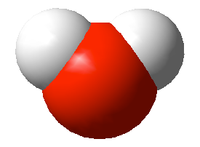
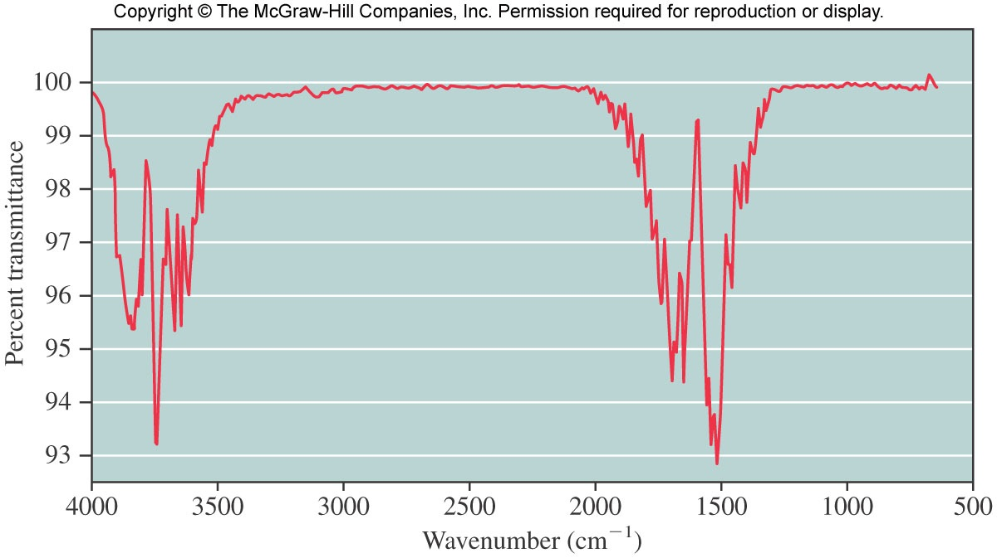
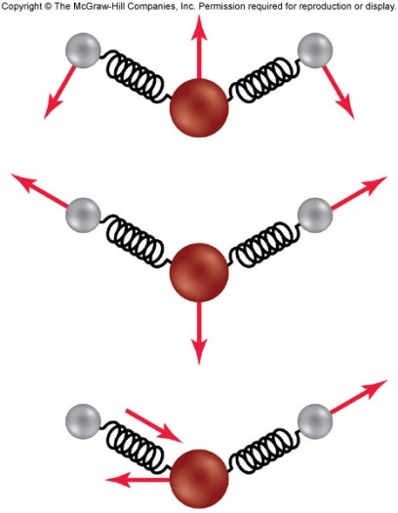
Vibrational Modes and IR Spectrum for Water
Infrared spectroscopy: shine IR light (heat) onto a substance, record what energies of light are absorbed (transmittance decreases when light is absorbed)
link to water vibrations!
note: wavenumber (cm⁻¹) = 10,000,000 / λ (nm)
stretching
bending

Slide 17
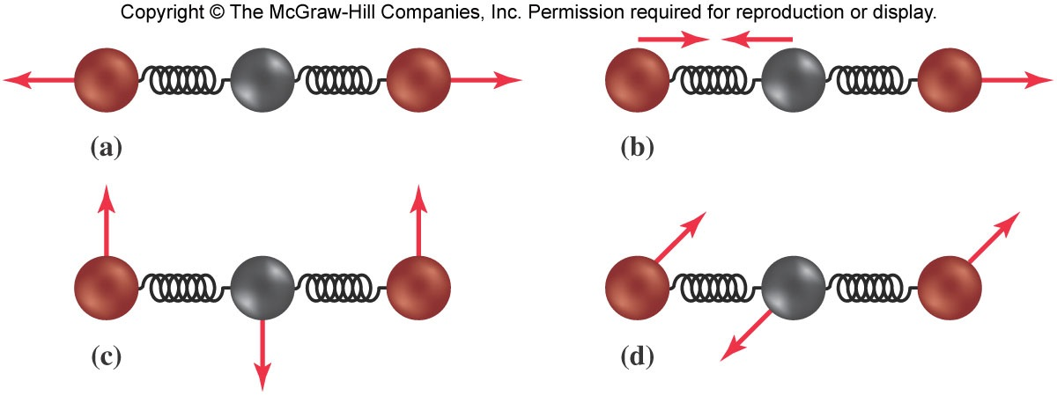
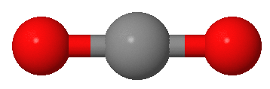
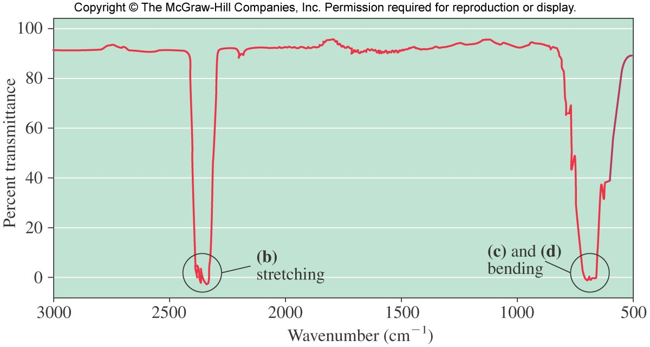
Vibrational Modes for Carbon Dioxide and Infrared Spectrum
a & b: stretching
modes
link to CO₂ vibrations!
c & d: bending
modes
Which of these vibrational modes can be turned on by the absorption of IR photons?
(need change in center of mass of molecule)

Slide 18
Why is CO₂ Important for Global Warming?
It’s difficult to imagine a molecule better suited to soaking up the IR photons radiating from the Earth than carbon dioxide:
Blue line: the theoretical spectrum of IR energy emitted by the Earth (assuming no atmosphere)
Red line: the spectrum of what is actually radiated from the Earth
Note 900-1250 cm⁻¹ range: most of this radiation escapes into space—if a gas absorbs in this range it has greater global warming potential…
CO₂ bending
H₂O bending
Prof Keith Shine at the University of Reading

Slide 19
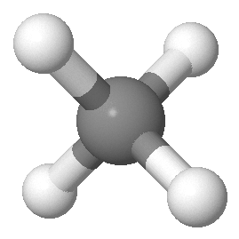
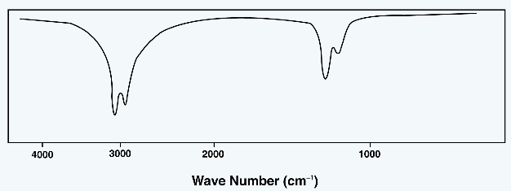
Methane
Is methane a greenhouse gas? If so, it needs to show vibrations that change its center of mass…
Click on molecule to link to CH₄ vibrations!
Also, the fact that there are absorptions of IR energy (the lowered transmittances at ~1200 and 3000 cm⁻¹) indicate that methane can absorb IR radiation and act as a greenhouse gas.

Slide 20
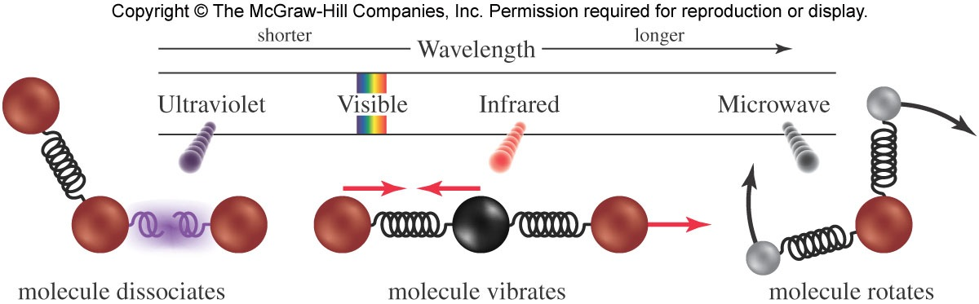
Review of How Light Interacts with Matter
Visible—depending on the energy and substance of interest, sometimes it breaks bonds, sometimes not; vibrations almost always accompany the excitation; in some cases visible light is re-emitted by the excited substance (fluorescence and phosphorescence)

Slide 21
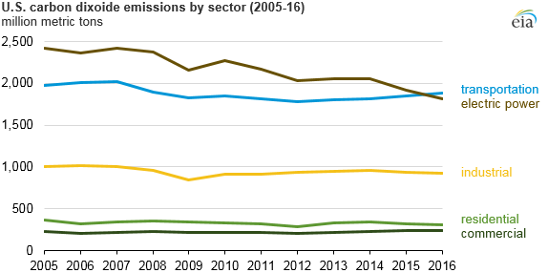
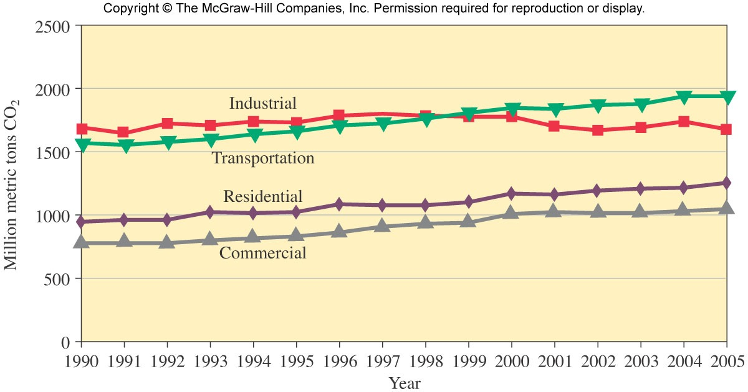
US Emissions of CO₂
If CO₂ is participating in the enhanced greenhouse effect, it would be good to know how much is being made with respect to how much C is in the world…
6 Gt
Gt=gigatonne (a billion (10⁹) metric tons, 2200 billion pounds (2.2x10¹²)

Slide 22
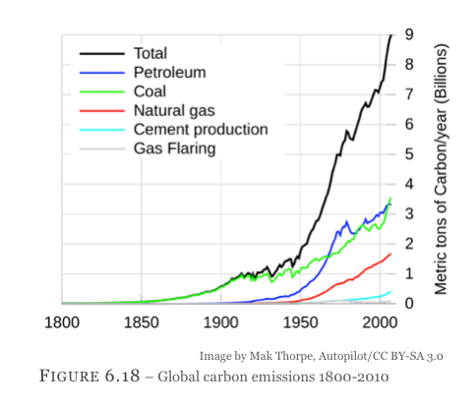
Carbon Emissions During Industrial Times

Slide 23
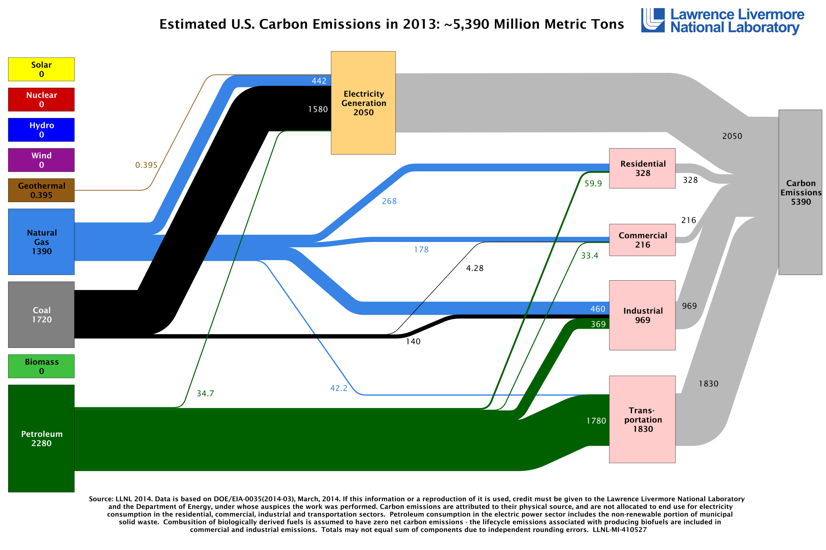
A Different Look at US CO₂ Emissions (2013)
End Uses
Sources
In millions of metric tons

Slide 24
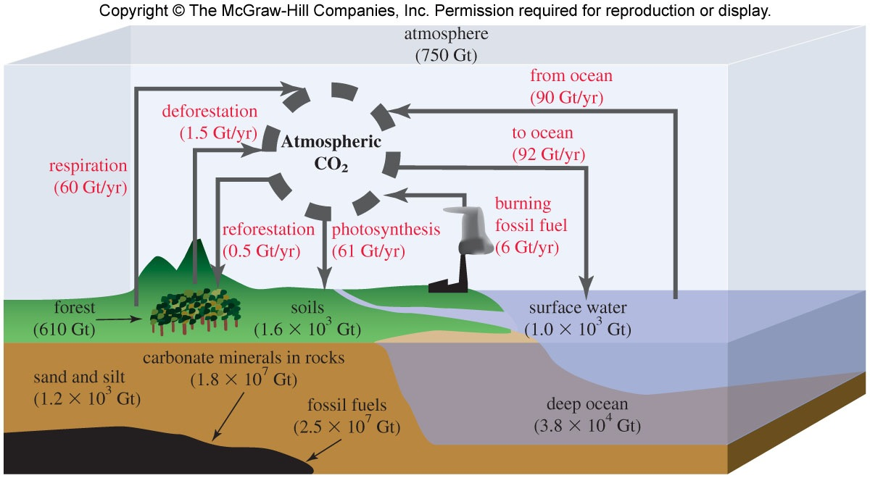
Carbon (C) Cycle
De-reforestation 1 Gt/year
Burning fossil fuels 6 Gt/year
Total: 7 Gt/year
Net to ocean 2 Gt/year
Respiration-Photosynthesis 1 Gt/year
Total: 3 Gt/year
~3-4 Gt C/year addition to atmosphere
Gt=gigatonne (a billion metric tons (10⁹), 2200 billion pounds (2.2x10¹²)

