Slide 1
Sustainability Profile
Ammonia (NH3)

Slide 2
Industrial Production of Ammonia
N2(g) + 3H2(g) ⇌ 2NH3(g)
Industrial process is known as the Haber-Bosch process
Named after early 20th century German chemists
Fritz Haber and Carl Bosch
1919 Nobel prize for Haber—1931 for Bosch
An early application of Le Chatelier’s Principle
An exothermic reaction (∆H = –91.8 kJ/mol)
so high temperature favors reactants
High pressure favors NH3 production
(more moles of gas in reactants than products)
Condensation converts NH3(g) to NH3(l) removes product
and favors further product formation

Slide 3
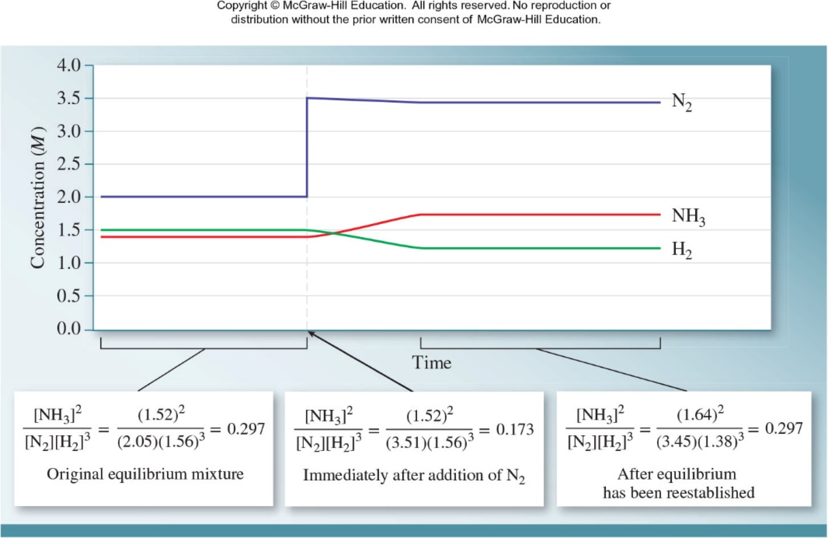
LeChatelier’s Principle and NH3 Synthesis

Slide 4
Naturally Occurring Nitrogen Fixation
Nitrogen is abundant as N2(g) in the earth’s atmosphere (78%)
N2 has a strong triple bond not easily broken
Nitrogen is accessible to organisms as a nutrient only when it is “fixed”, i.e. converted to nitrates (NO3–), nitrites (NO2–), ammonium (NH4⁺) compounds, and ammonia (NH3)
Lightning causes N2(g) and O2(g) to form NO(g)
which eventually forms nitrates (NO3–) and nitrites (NO2–)
Nitrogen can also be fixed by bacteria and archaebacteria in soils; nitrogen fixing bacteria are associated with the roots of legumes

Slide 5
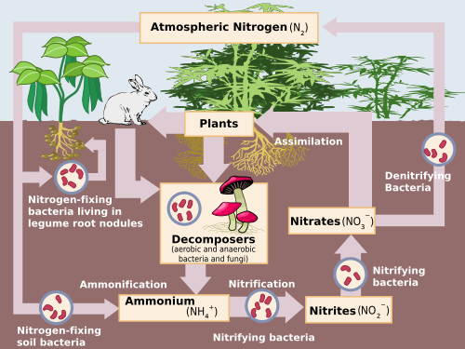

Slide 6
Haber–Bosch Nitrogen Fixation
Today 175 million tonnes of NH3 are produced
About half of the nitrogen found in living
systems is fixed by this method
The main use is as nitrogen containing fertilizers:
ammonia, nitrates, urea
The second main use of ammonia is in the
production of explosives. Nitric acid produced
from ammonia is used to add nitrate groups to organic compounds to make TNT and nitroglycerin (dynamite). This was Haber’s interest during World War 1.
2C3H5N3O9(l) → 5H2O(g) + 6CO2(g) + 3N2(g) + 1⁄2O2(g)
∆H = –1414 kJ/mol (highly exothermic) and produces 7.25 moles of gas per mole

Slide 7
Ammonia and World Population
Late 19th century scientist feared that the available fixed nitrogen from bat and seabird guano and salt peter (KNO3) mineral deposits would run out and agriculture could not support the growing human population, then under 2 billion
Today were nearly 8 billion in number largely due to
increased food production through the “green revolution”, a combination of higher yield crops, pesticides, and fertilizers produced via the Haber-Bosch process.

Slide 8
Nitrogen Pollution
Excess fertilizer runs off fields and into waterways and ultimately into the ocean causing algal blooms and oxygen depleted regions
These are known as dead zones
Nitrogen compounds are also converted to N2O (nitrous oxide) which is a greenhouse gas 300x more potent than CO2
N2O is responsible for around 6% of greenhouse gas emissions in CO2-equivalents

