Slide 1
21.6 Acid Rain
Topics
Acid Rain

Slide 2
21.6 Acid Rain (1)
Acid Rain
Every year acid rain causes hundreds of millions of dollars’ worth of damage to stone buildings and statues throughout the world.
The term stone leprosy is used by some environmental chemists to describe the corrosion of stone by acid rain.
Acid rain is also toxic to vegetation and aquatic life.

Slide 3

21.6 Acid Rain (2)
Acid Rain

Slide 4
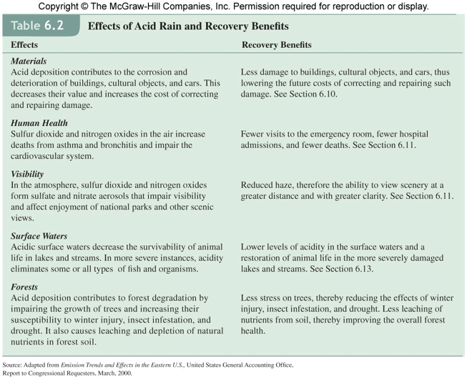

Slide 5

21.6 Acid Rain (3)
Acid Rain
Precipitation in the northeastern United States has an average pH of about 4.3:

Slide 6
21.6 Acid Rain (4)
Acid Rain
Sulfur dioxide (SO₂) and, to a lesser extent, nitrogen oxides from auto emissions are believed to be responsible for the high acidity of rainwater.
Acidic oxides, such as SO₂, react with water to give the corresponding acids.
There are several sources of atmospheric SO₂, including volcanic eruptions.

Slide 7
21.6 Acid Rain (5)
Acid Rain
Many metals exist combined with sulfur in nature.
Extracting the metals often entails smelting, or roasting, the ores—that is, heating the metal sulfide in air to form the metal oxide and SO₂. For example,
2ZnS(s) + 3O₂(g) → 2ZnO(s) + 2SO₂(g)
The metal oxide can be reduced more easily than the sulfide to the free metal.

Slide 8
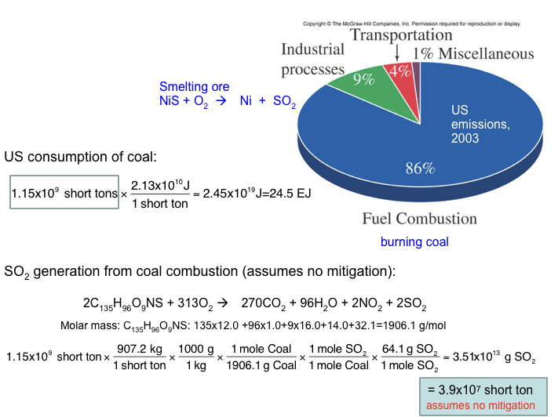

Slide 9
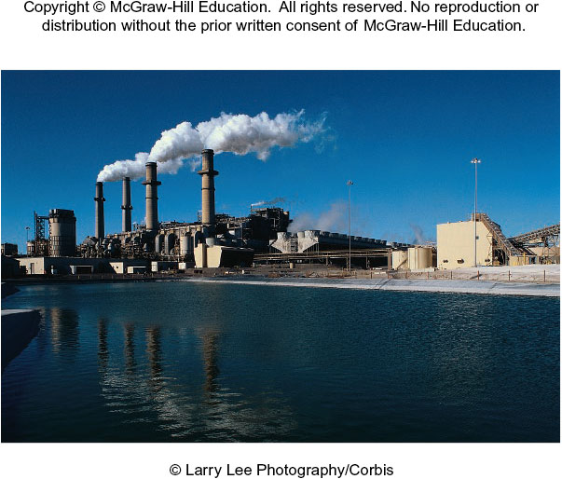
21.6 Acid Rain (6)
Acid Rain
The burning of fossil fuels in industry, in power plants, and in homes accounts for most of the SO₂ emitted to the atmosphere.
50 million to 60 million tons of SO₂ are released into the atmosphere each year!
Almost all oxidized to H₂SO₄ in the form of aerosol, which ends up in acid rain.

Slide 10
21.6 Acid Rain (7)
Acid Rain
The mechanism for the conversion of SO₂ to H₂SO₄ is quite complex and not fully understood.
The reaction is believed to be initiated by the hydroxyl radical (OH•):
OH + SO₂ → HOSO₂
The HOSO₂ radical is further oxidized to SO₃:
HOSO₃ + O₂ → HO₂ + SO₃

Slide 11
21.6 Acid Rain (8)
Acid Rain
The sulfur trioxide formed would then rapidly react with water to form sulfuric acid:
SO₃ + H₂O → H₂SO₄
Eventually, the acid rain can corrode limestone and marble.
CaCO₃(s) + H₂SO₄(aq) → CaSO₄(s) + H₂O(l) + CO₂(g)

Slide 12

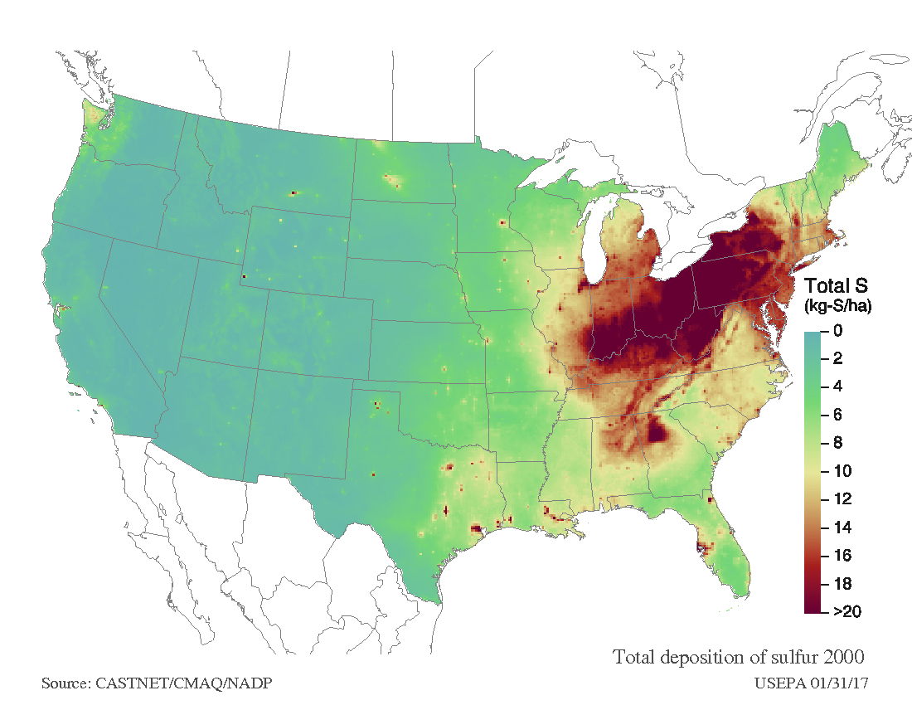


Acid Rain – Progress 2000-2015

Slide 13
21.6 Acid Rain (9)
Acid Rain
There are two ways to minimize the effects of SO₂ pollution:
remove sulfur from fossil fuels before combustion (difficult)
remove SO₂ as it is formed (limestone)

Slide 14
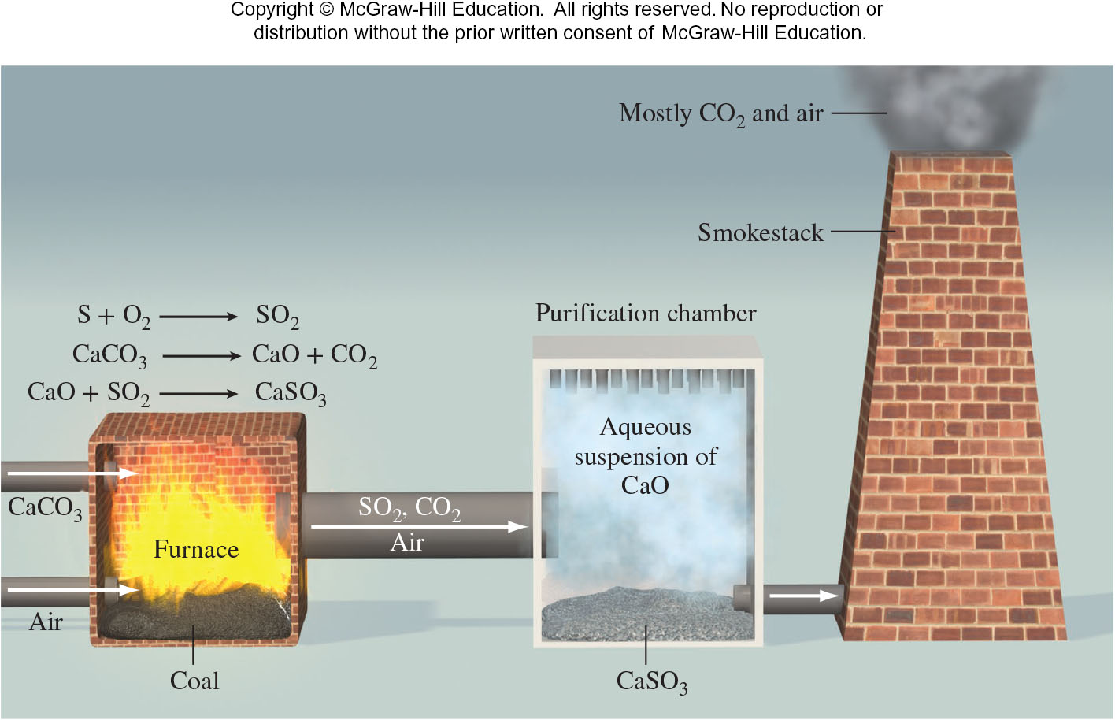
21.6 Acid Rain (10)
Acid Rain
Limestone is injected into the power plant boiler or furnace along with the coal.

Slide 15
21.6 Acid Rain (11)
Acid Rain
At high temperatures, the following decomposition occurs:
CaCO₃(s) → CaO(s) + CO₂(g)
limestone quicklime
The quicklime reacts with SO₂ to form calcium sulfite and some calcium sulfate:
CaO(s) + SO₂(g) → CaSO₃(s)
2CaO(s) + 2SO₂(g) + O₂(g) → 2CaSO₄(s)

Slide 16
21.6 Acid Rain (12)
Acid Rain
Quicklime is also added to lakes and soils in a process called liming to reduce their acidity.

