Slide 1





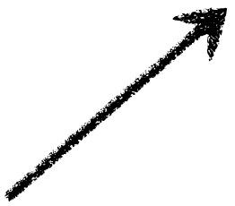

The Chemical Equation
State of Matter
C2H6O(l) + 3 O2(g) ----> 2 CO2(g) + 3 H2O(g)
Reactants
Products
Coefficients (not written if it is a 1)
One molecule of liquid ethanol (C2H6O) reacts with three molecules of gaseous oxygen (O2) to form two molecules of gaseous carbon dioxide (CO2) and three molecules of gaseous water (H2O).
A chemical equation is balanced with respect to the number and type of atoms on each side of the equation

Slide 2
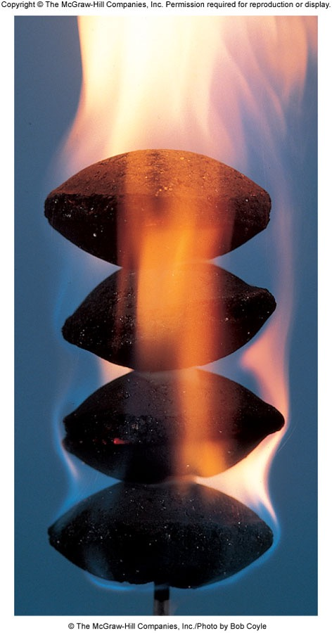
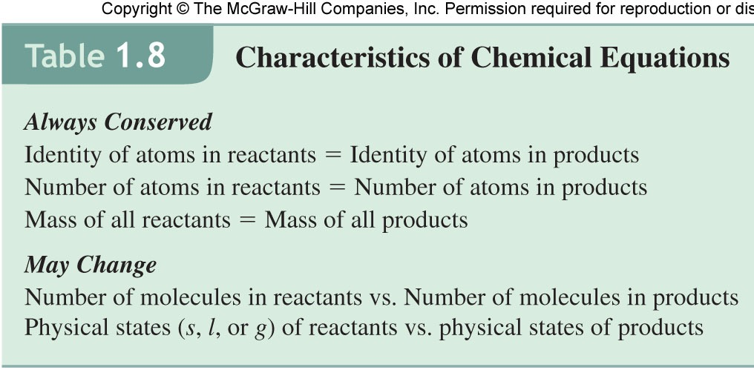
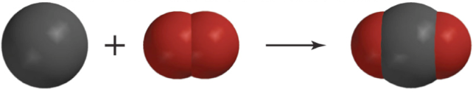
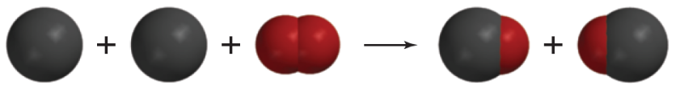
Chemical Changes Described by Chemical Equations
Chemical equation: Reactant(s)
Product(s)
Carbon reacts with oxygen to form carbon dioxide (complete combustion):
C + O₂ CO₂
balanced equation
subscripts: # of atoms in a molecule
# in front = # of molecules in eqn.
When not enough O₂ is present, carbon monoxide is produced, and CO poisoning can occur:
C + O₂ CO
2C + O₂ 2CO

Slide 3
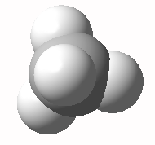
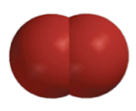
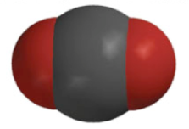
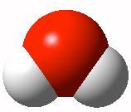
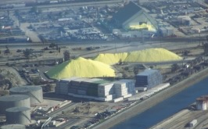
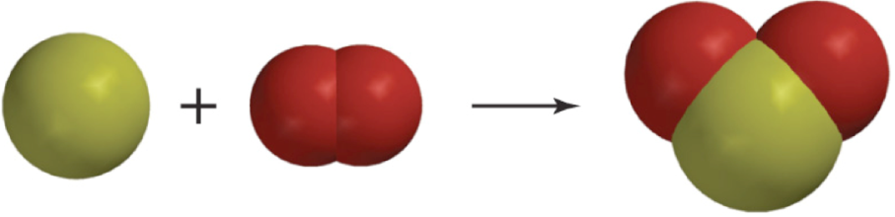
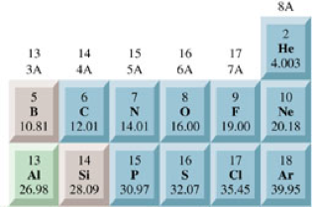
Burning to Balance Equations
Natural gas combustion: methane plus oxygen produces carbon dioxide plus water
CH₄ + O₂ → CO₂ + H₂O not balanced: 4 H’s on left and 2 H’s on right, 2O’s on left & 3 on right
CH₄
+
O₂
+
O₂
CO₂
+
H₂O
+
H₂O
CH₄ + 2O₂ → CO₂ + 2H₂O
# in front indicates # molecules
Subscripts: # of atoms in a molecule
2x2=4
Small amount of sulfur present in coal
(it’s removed during petroleum refining)
S + O₂ → SO₂
S
+
O₂
SO₂

Slide 4
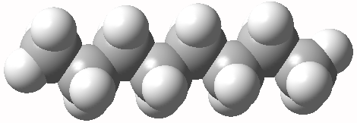
Tips for Balancing Chemical Equations
What about burning gasoline?
Octane, C₈H₁₈
Molecule + O₂ forms CO₂ + H₂O
C₈H₁₈ + O₂ → CO₂ + H₂O
C₈H₁₈ + O₂ → 8CO₂ + H₂O
C₈H₁₈ + O₂ → 8CO₂ + 9H₂O
8x2+9 O’s on product side (25 O’s), leads to 12 ½ O₂ can’t have fractions
2C₈H₁₈ + 25 O₂ → 16CO₂ + 18H₂O
If an element is present in just one compound on each side, balance it first
Balance anything that exists as a free element last
Balance polyatomic ions as a unit
Check when done – same number of atoms, and same total charge (if any) on both sides
Burning propane?
C₃H₈
+ O₂ → CO₂ + H₂O

Slide 5
Patterns of Chemical Reactivity
Three of the most commonly encountered reaction types are combination, decomposition, and combustion.
Combination—two or more reactants combine to form a single product
NH₃(g) + HCl(g) → NH₄Cl(s)
Decomposition—two or more products form from a single reactant
CaCO₃(s) → CaO(s) + CO₂(g)
Combustion—a substance burns in the presence of oxygen. Combustion of a compound that contains C and H (or C, H, and O) produces carbon dioxide gas and liquid water.
CH₂O(l) + O₂(g) → CO₂(g) + H₂O(l)

Slide 6
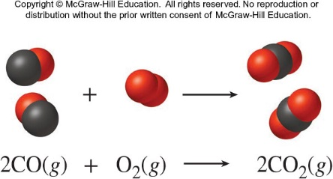
Calculations with Balanced Chemical Equations
8.3
Balanced chemical equations are used to predict how much product will form from a given amount of reactant.
2 moles of CO combine with 1 mole of O₂ to produce 2 moles of CO₂.
2 moles of CO is stoichiometrically equivalent to 2 moles of CO₂.

Slide 7
Calculations with Balanced Chemical Equations (2)
Consider the complete reaction of 3.82 moles of CO to form CO₂. Calculate the number of moles of CO₂ produced.

Slide 8
Calculations with Balanced Chemical Equations (3)
Consider the complete reaction of 3.82 moles of CO to form CO₂. Calculate the number of moles of O₂ needed.

Slide 9
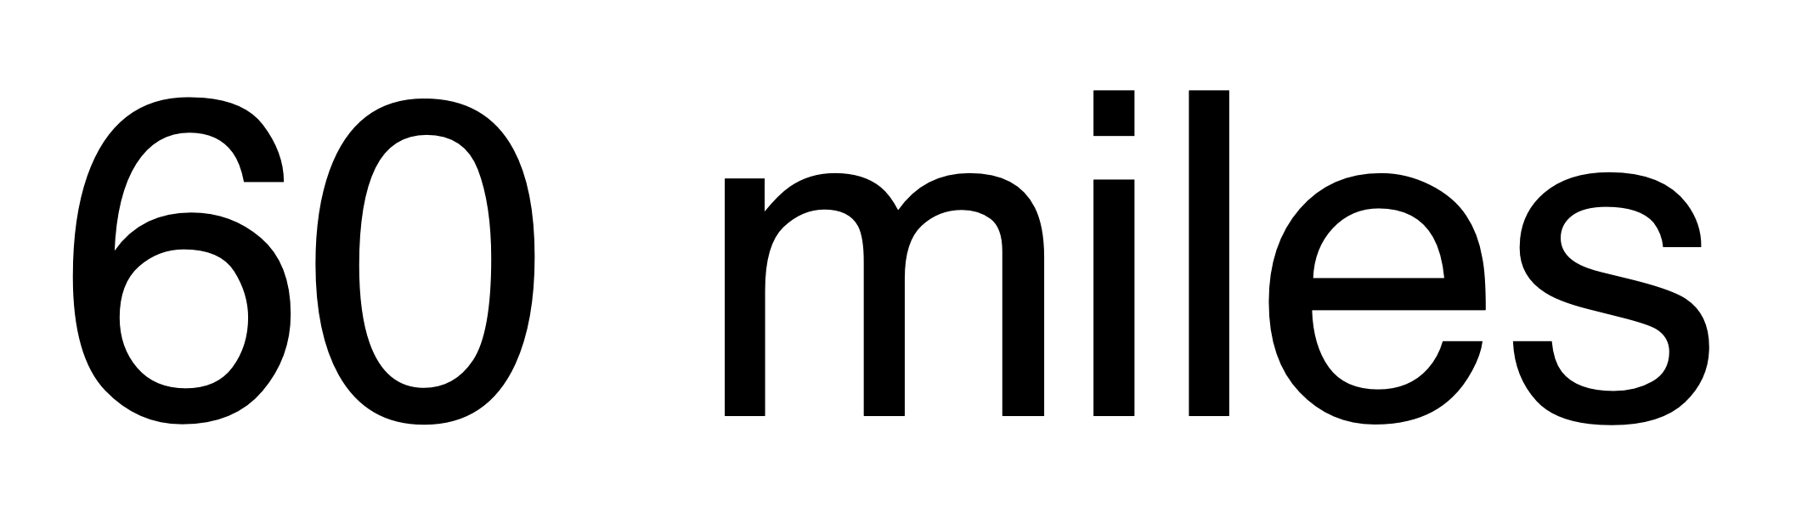
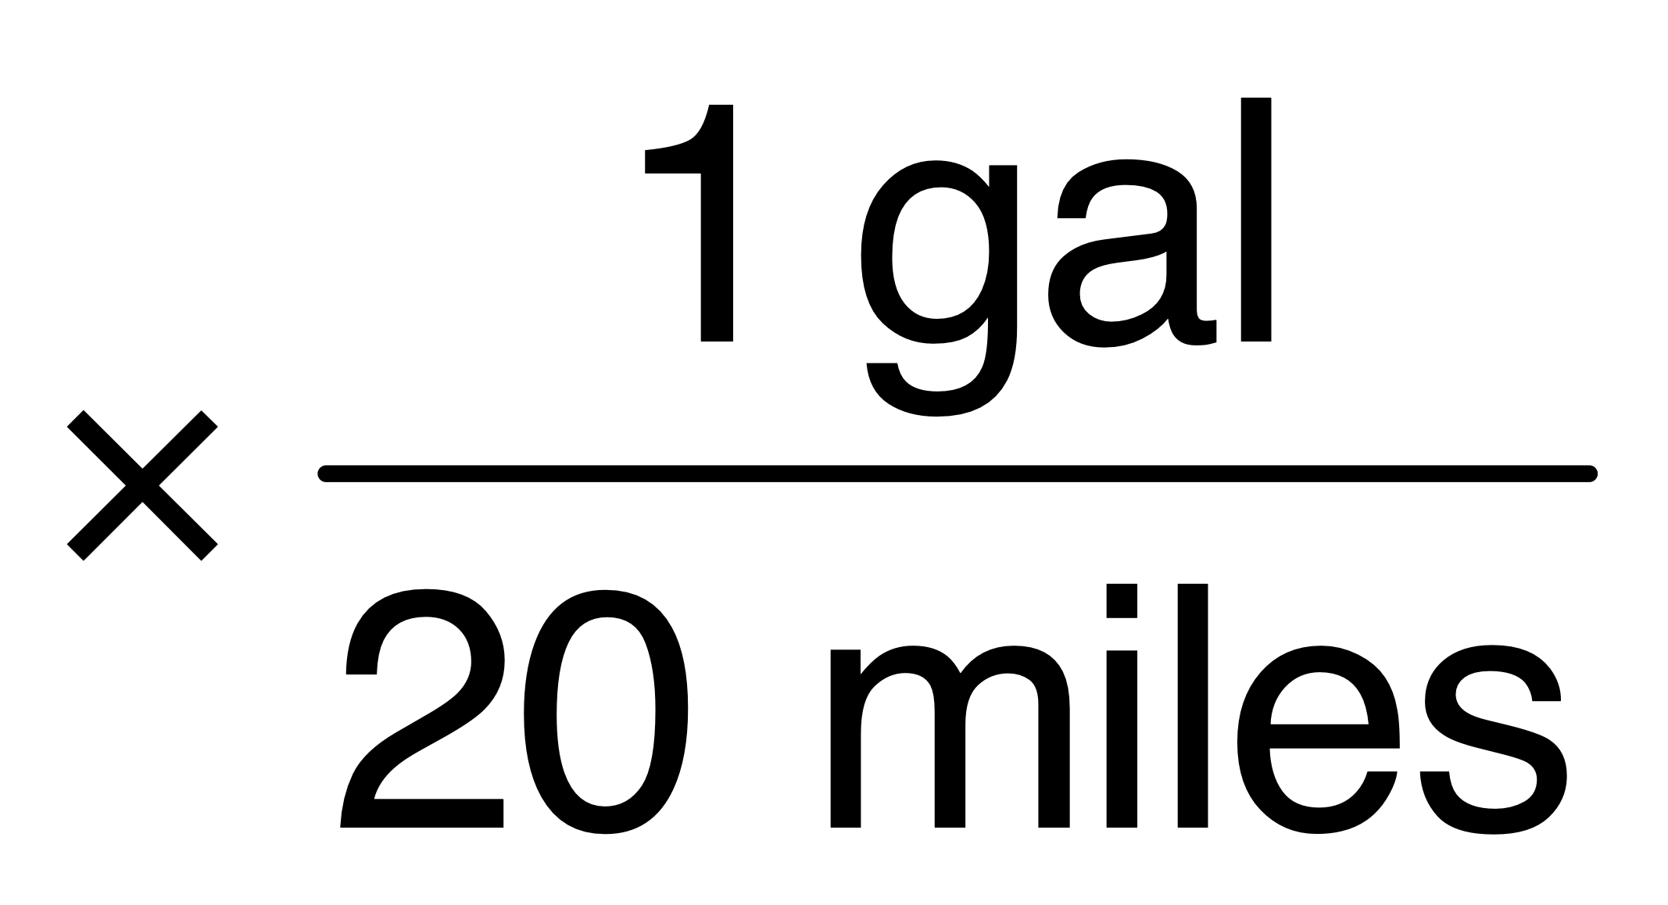
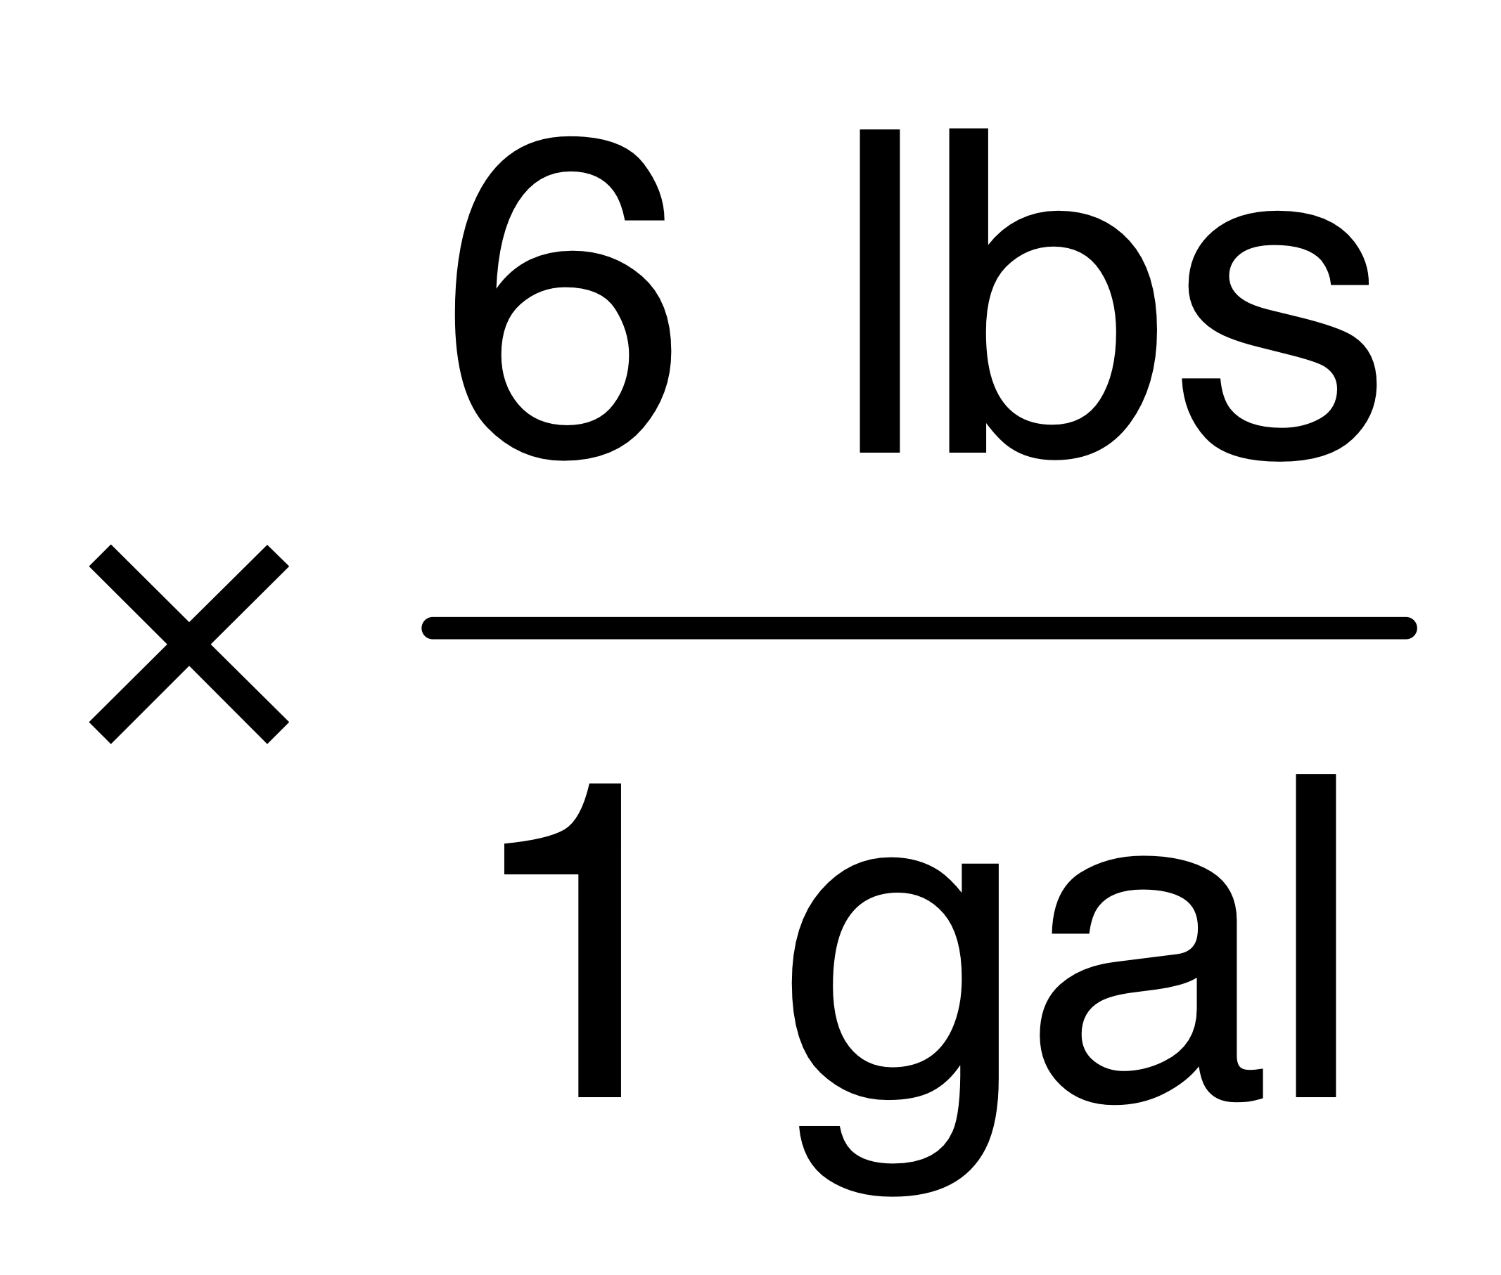
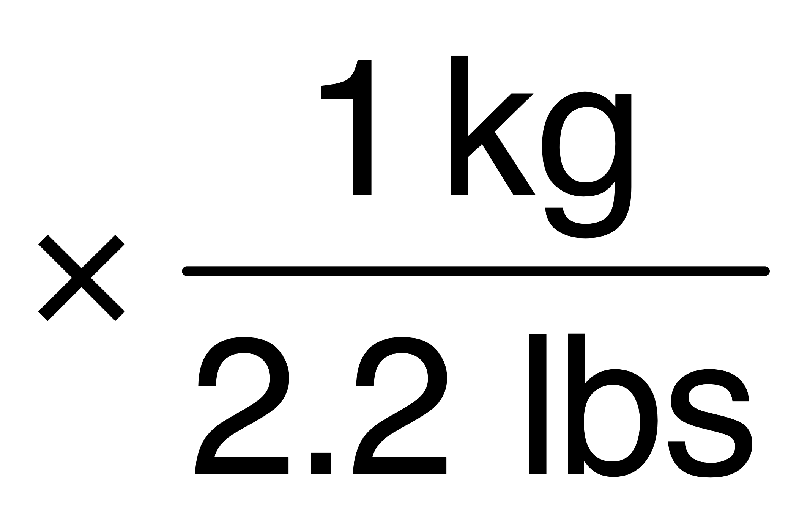
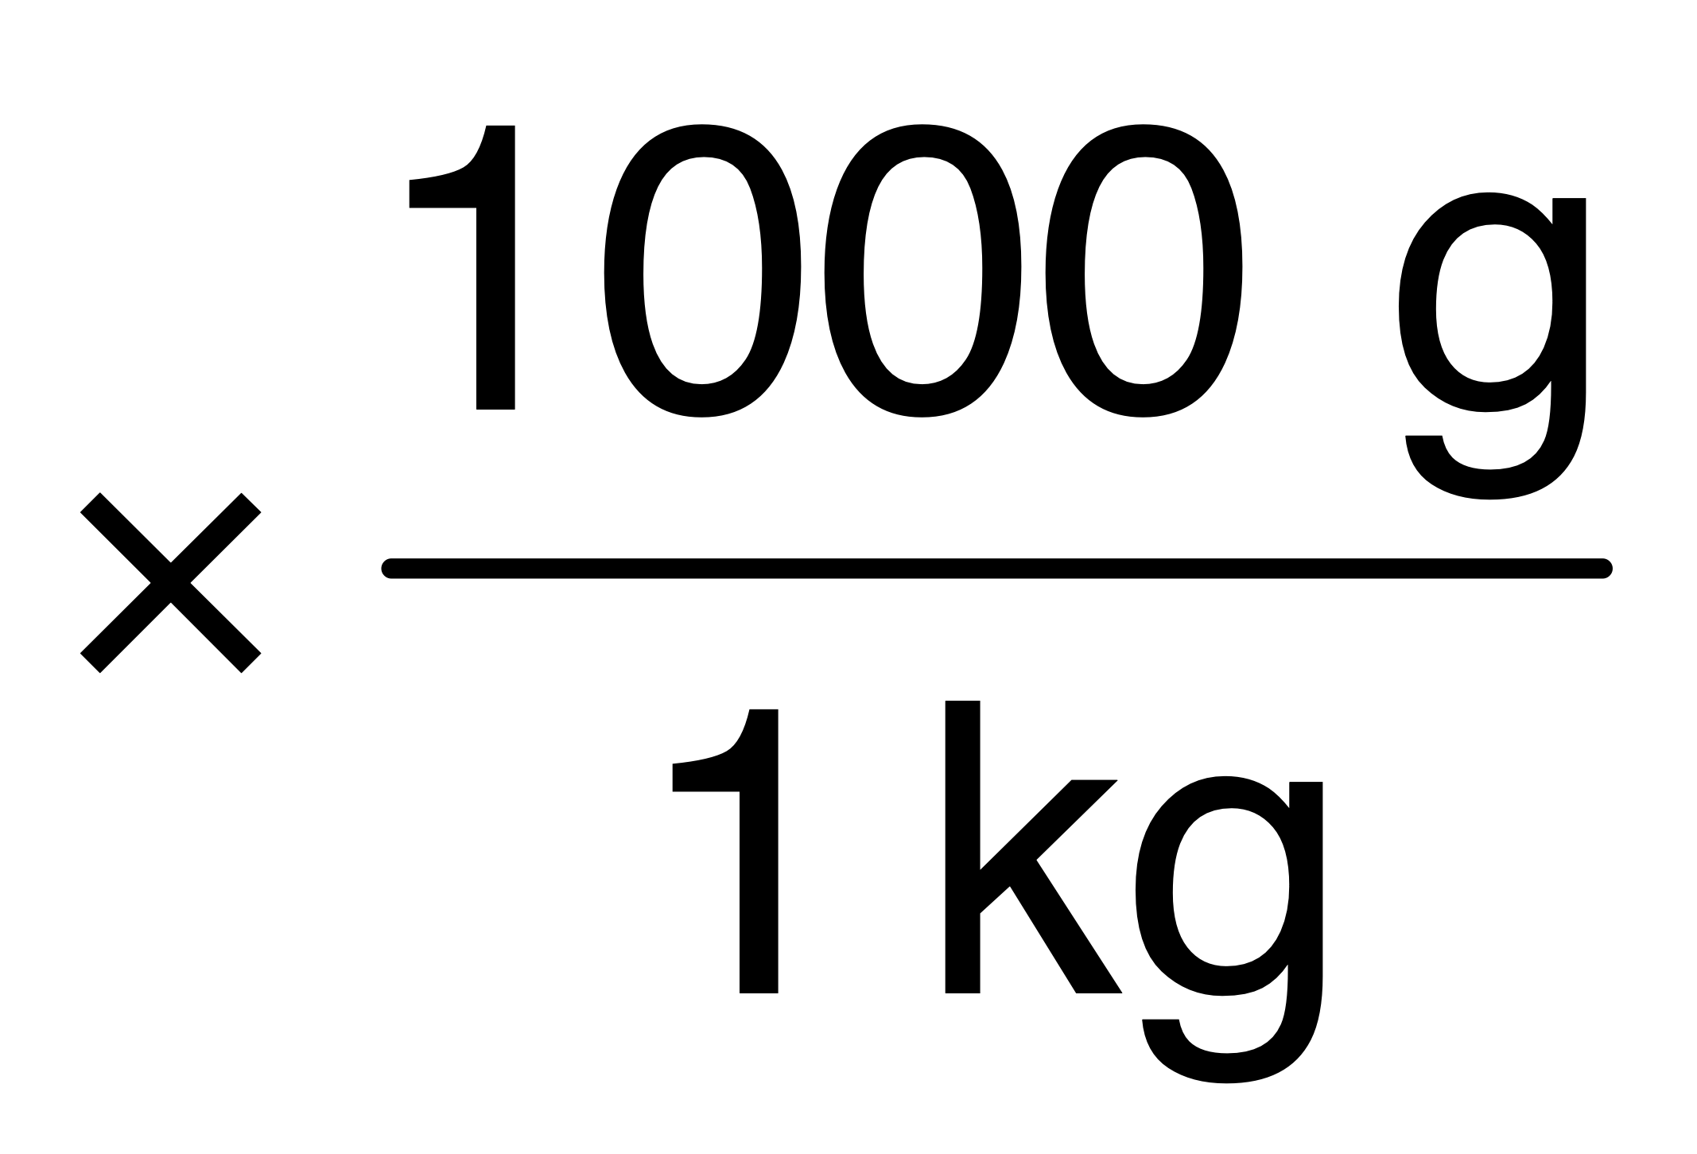
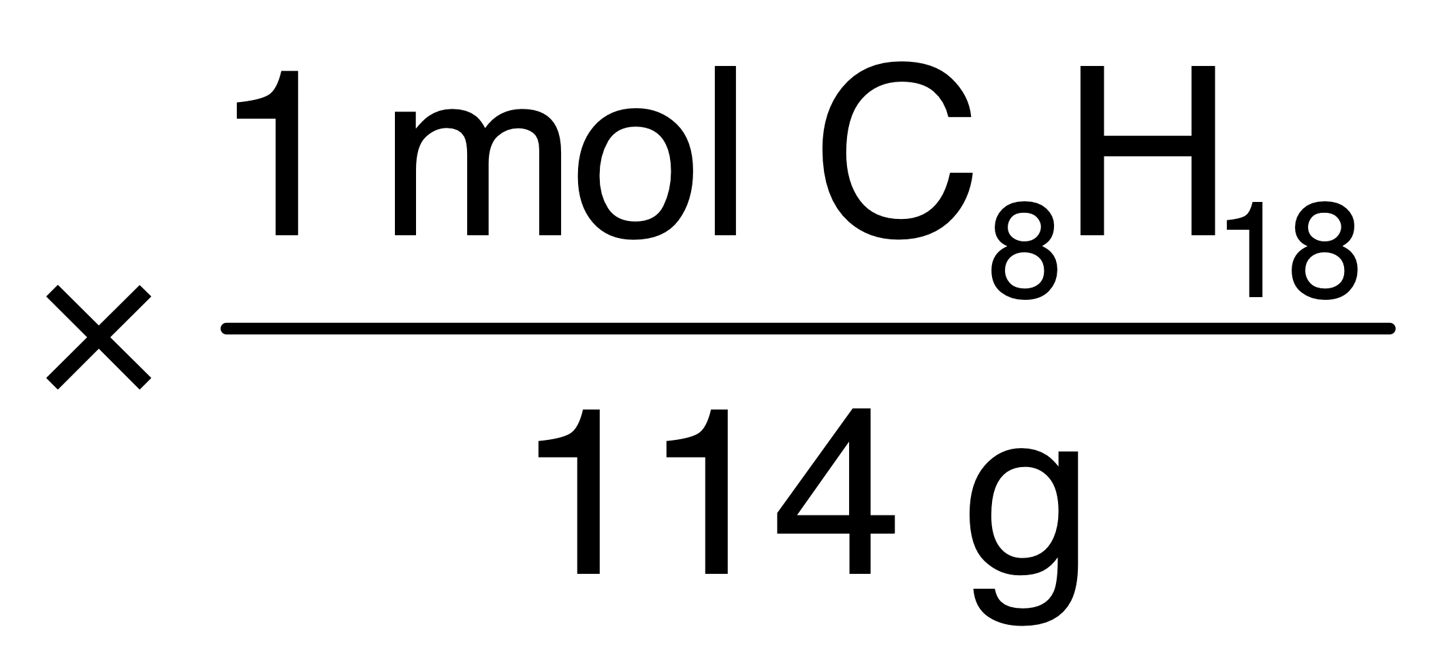
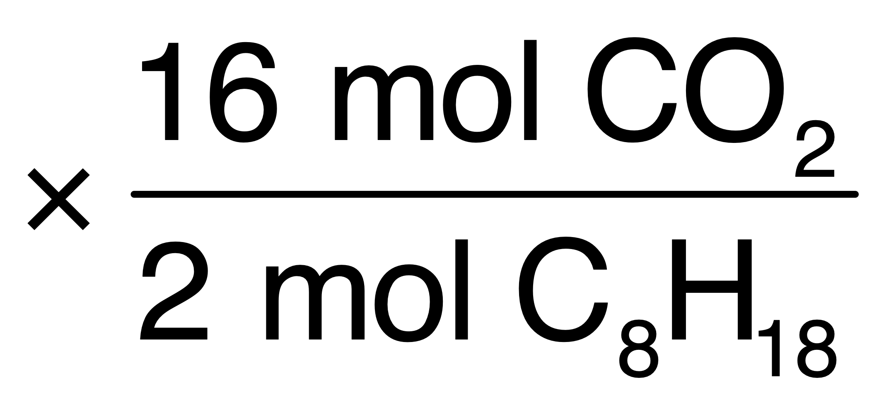
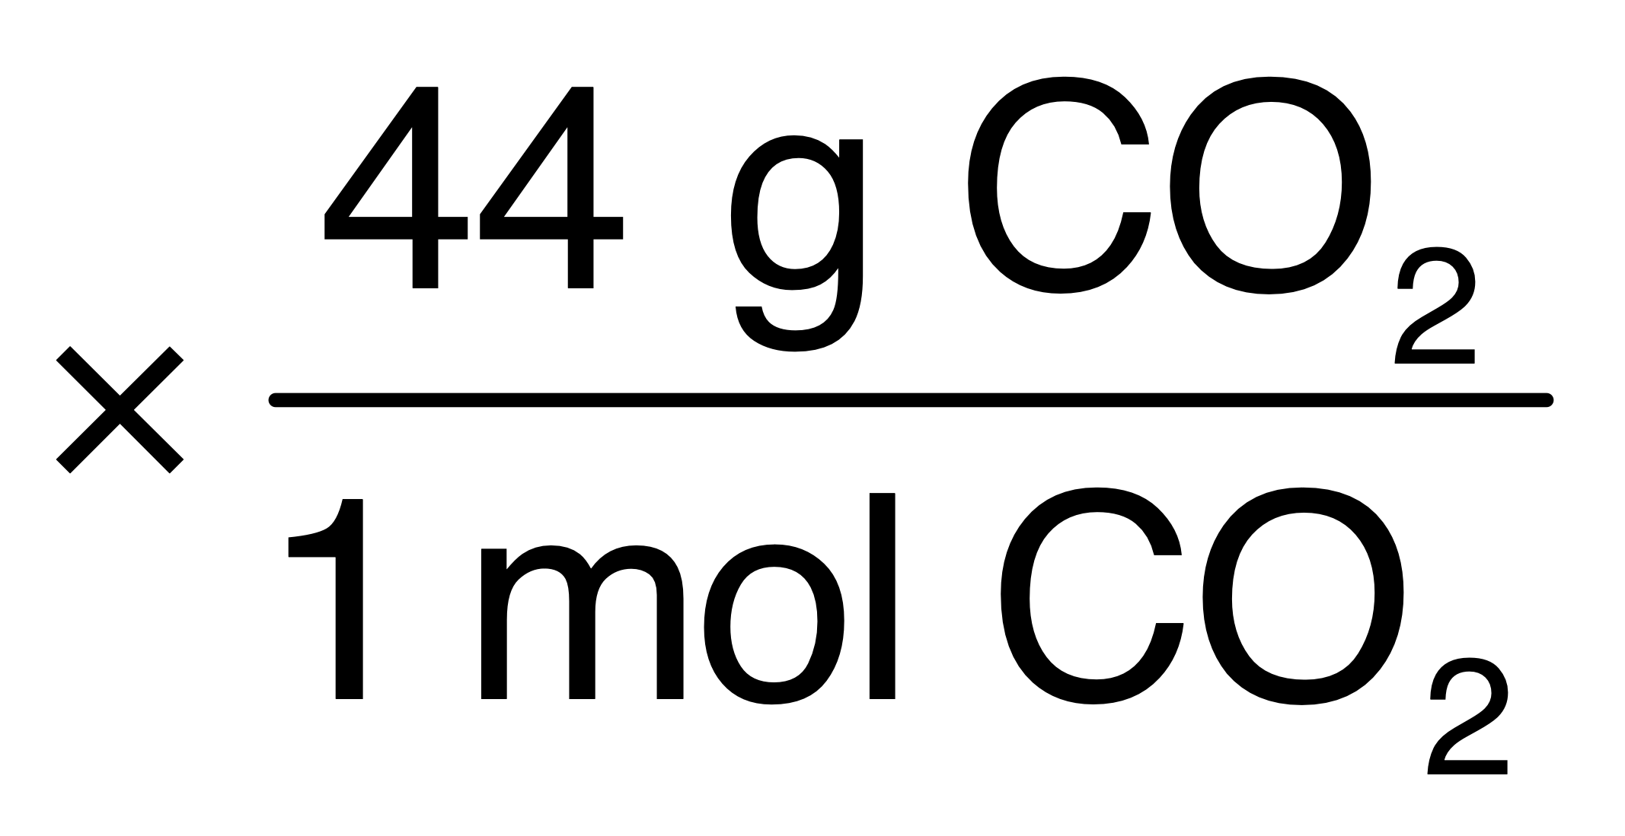
How much CO₂ do you emit when you drive to Denver?
= 8,200 g gasoline used, but we want to know how much CO₂ was produced while driving that distance…
Molar mass of gasoline? (assume C₈H₁₈)
8x12.0 g = 96.0 g
18x1.0 g = 18.0 g
= 114.0 g/mol C₈H₁₈
Converting from C₈H₁₈ to CO₂?
2 C₈H₁₈ + 25 O₂ → 16 CO₂ + 18 H₂O
2 moles C₈H₁₈ = 16 moles CO₂
Molar mass of CO₂?
1x12.0 g = 12.0 g
2x16.0 g = 32.0 g
= 44.0 g/mol CO₂
Building Solution here: 8,200 g gasoline
= 25,000 g CO₂

Slide 10
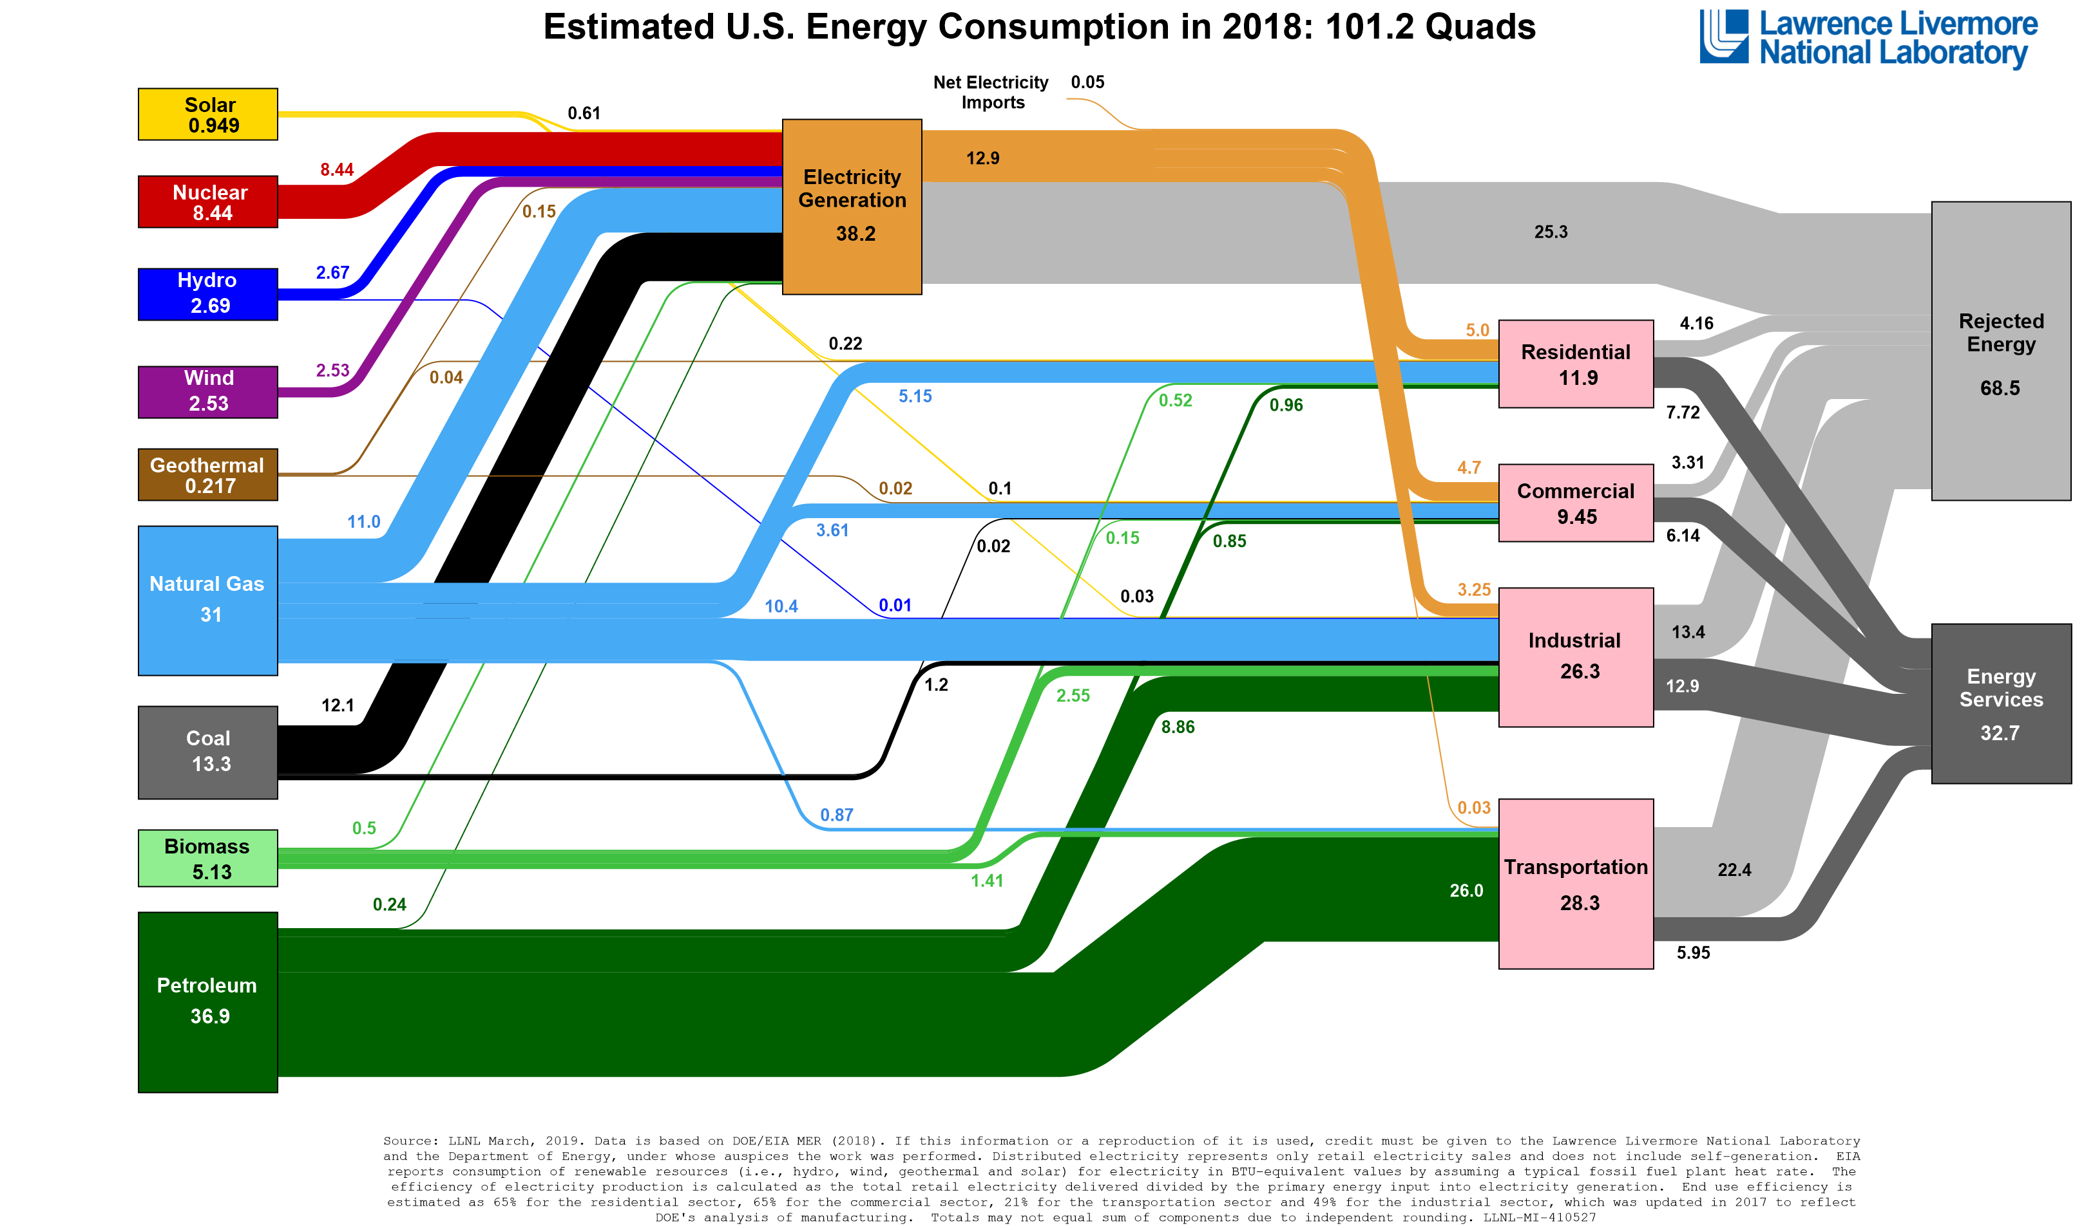
Energy Flow
https://flowcharts.llnl.gov
~100 EJ
1 Quad = 1.055 EJ

Slide 11
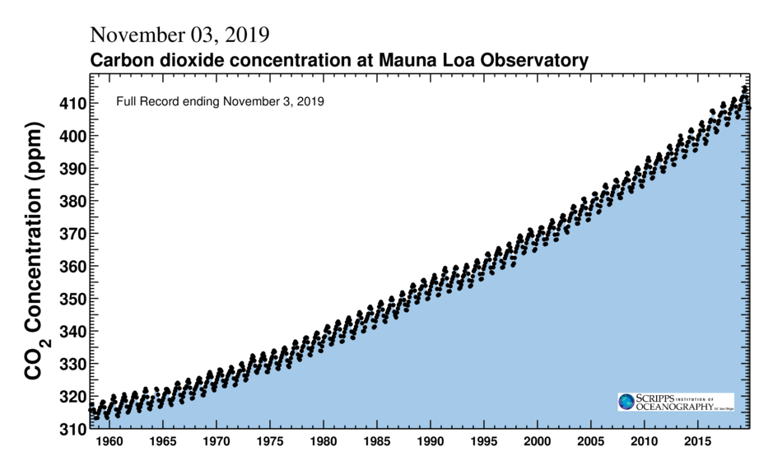

Slide 12
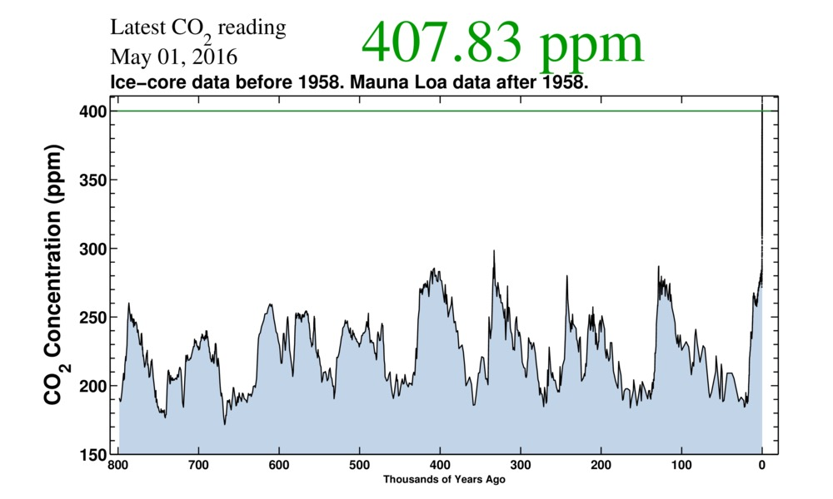
CO2 Concentrations

Slide 13
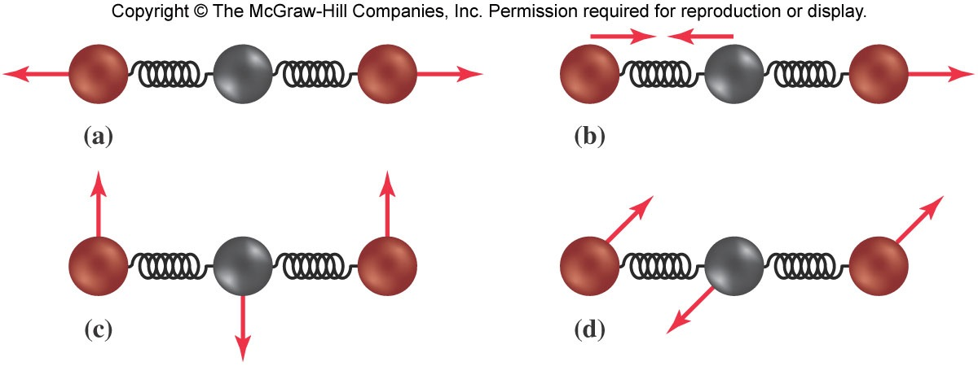
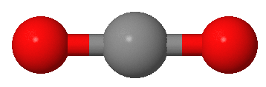
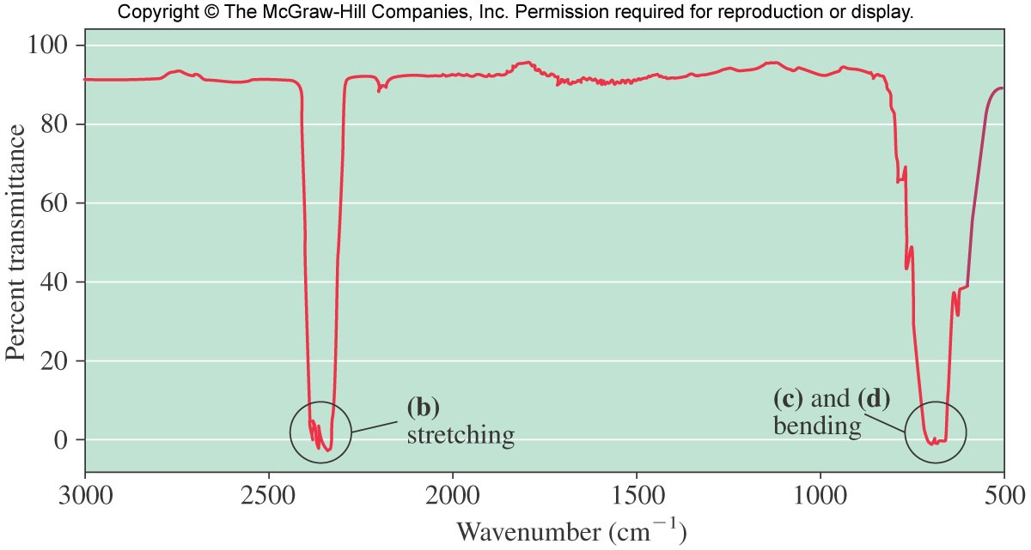
Vibrational Modes for Carbon Dioxide and Infrared Spectrum
a & b: stretching
modes
link to CO₂ vibrations!
c & d: bending
modes
Which of these vibrational modes can be turned on by the absorption of IR photons?
(need change in center of mass of molecule)

